Slide 1
Stress

Slide 2
What is stress?
Stress is the effect that any situation or event has on the body and mind. Stress is change that must be adjusted to. Stressful events include injury, illness, or the death of a loved one.
These are negative events, but stressful events can also be those things that are positive, such as graduating from high school, getting a new job, or moving to a new home. Sources of stress can come from the environment or the body.

Slide 3
Types of stress
There are two types of stress:
Eustress- which is “good” stress, and can produce a positive outcome.
2) Distress - or “bad” stress. Distress is something negative that can result in a negative effect.
THOUGHT- What are some examples of Eustress or Distress that you have experienced in your life? (2 min discussion)

Slide 4
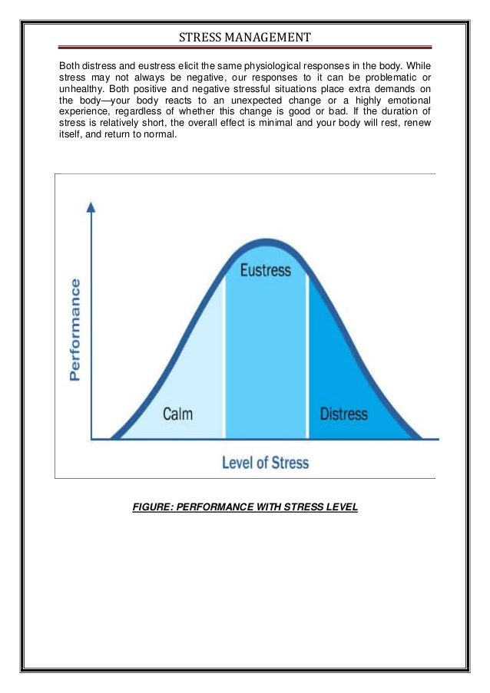

Slide 5
How does one respond to stress?
The General Adaptation Syndrome (GAS) is the body changes that occur when a person experiences stress.
There are three stages of this:
1) Alarm Stage
2) Resistance Stage
3) Exhaustion Stage

Slide 8
alarm
Alarm stage– something happens and the body releases adrenaline and cortisol, chemicals from the brain. The heart beats faster, there is a burst of energy, blood flow increases, breathing quickens, muscles tighten, and blood is directed from the digestive system to the muscles. The pupils widen, the senses become more acute.
THOUGHT: How does this serve as an evolutionary function of humans?

Slide 9
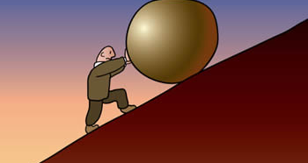
Resistance

Slide 10
resistance
Resistance Stage - the body tries to recover from stress reaction and return to homeostasis, or normal functioning. Sometimes this happens right away, as when a runner runs a race and then is done with the race. Also, when you feel nervous and then realize everything is okay (a police man follows you, you think you are speeding, then he passes you and pulls over someone else). You can immediately feel your body relax.
Homeostasis: Maintaining of balance in a system of functions.

Slide 11
Resistance cont’d
Smoking, drinking, or taking drugs are all ways of masking feelings while attempting to relieve stress.
If this is the only they have learned to deal with stressors, an addiction is likely. After the person is sober again, the body still must cope with the stress. If the body cannot rid itself of excess stress, the body goes on to the third stage of the general adaptation syndrome……

Slide 12
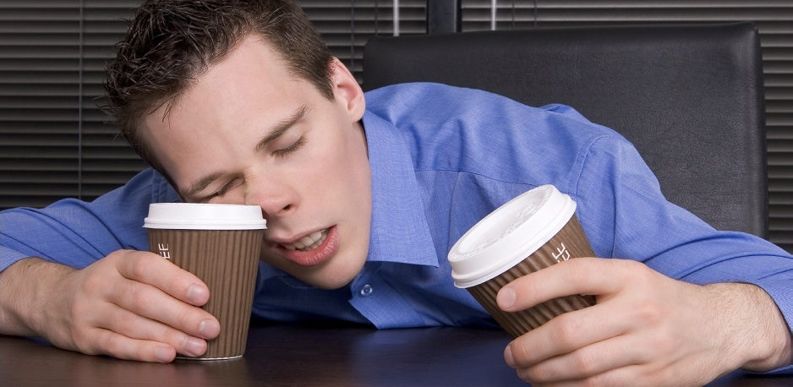
exhaustion

Slide 13
exhaustion
If a person does not utilize adequate coping strategies, their body goes into the exhaustion phase. This is when they may become ill, have high blood pressure, a heart attack, or even die. The person will be less able to resist new stressors and will become stressed easily by inconsequential things.

Slide 14
Questions
1) How can cortisol have a positive effect on the body? How does too much cortisol have a poor effect on the body?
2) Why are Type-A personalities at such a larger risk for heart disease?
3) What effect does Stress have on the immune system? Why does this increase one’s chance of sickness?
4) Brainstorm as many positive ways to manage stress as you can in a small group. Then, brainstorm all of the negative ways to manage stress.

