Slide 1
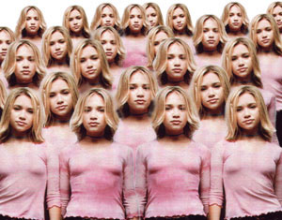
Social Psychology
Social psychology examines how other persons influence our thoughts, feelings and actions
Do you feel pressure to dress like everyone else?

Slide 2
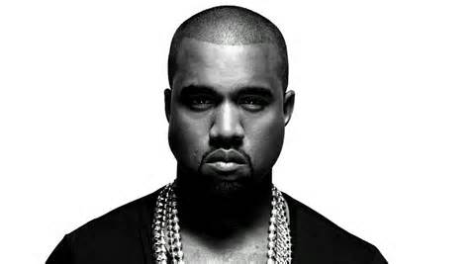
Influence
We are influenced by others in our:
Thoughts include attitudes and attributions
Feelings include attraction and dislike
Actions include social influence, aggression, and altruism
Which celebrity do you identify with?
Do they share you values and beliefs?

Slide 3
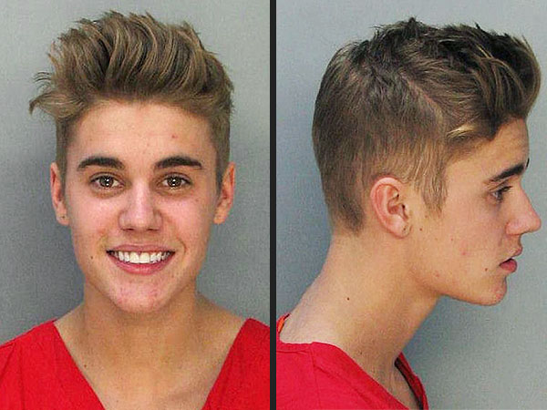
Attributions
Attributions are statements that explain why people do what they do
Why did Justin Bieber throws eggs
At someone's house?
Why did he speed while intoxicated?
Why did he refuse to stop smoking
marijuana on a plane?

Slide 4
Attributions
Dispositional: the actions of a person are related to their internal character
“Luongo let in a goal, he isn’t trying hard enough.”
Situational: the actions of a person are related to the external characteristics of their situation
“Luongo let in a goal, he must not have seen it in time.”
You see a homeless man begging for change outside 7-11, how would you make a
situational or dispositional attribution?

Slide 5
Attribution Errors
Fundamental attribution error (FAE) occurs when we judge the behavior of others as due to dispositional factors
Exampe, “He is speeding because he doesn't care about other peope.”
What could a situational attribution be for speeding?

Slide 6
Attribution Errors
Self-serving bias: we tend to take undue credit for positive outcomes and blame negative outcomes to external causes. The self-serving bias maintains our self-esteem
Example: “I did badly on the test because the test was badly written.”
Try and think of an example where you have blamed external causes.

Slide 7
Attitudes
Attitudes are learned predispositions to respond to a particular object, person or situation in a particular way. They are usually learned during interaction with others.
Attitudes involve:
Cognitions: thoughts and beliefs
Emotions: feelings about the object
Behaviors: how we act toward the object
Are your attitudes toward certain things different than your parents? Can you think of an example?

Slide 8
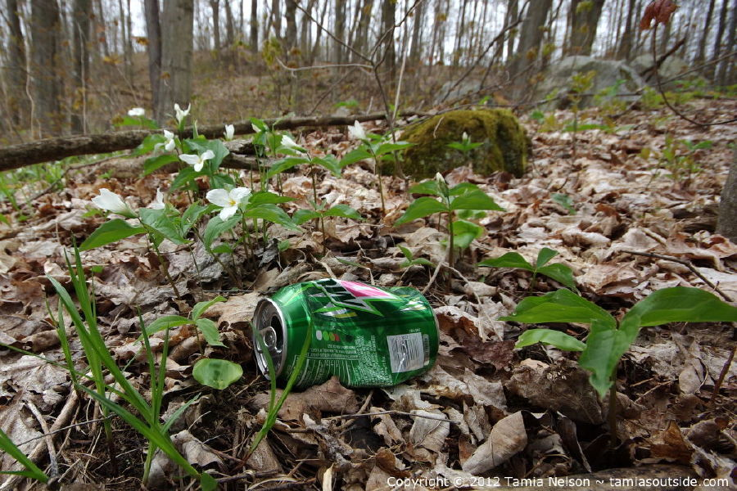
Attitudes
Cognitive Dissonance (an uncomfortable feeling caused by holding two contradictory ideas simultaneously) can prompt attitude change.
A). I don’t litter, I recycle.
B). I’m just littered in the forest because I did not want to carry the can for hours.
What is easier to do change actions or attitudes?

Slide 9
Cognitive Dissonance
We reduce cognitive dissonance by changing our attitudes to match our actions

Slide 10
Foot-in-the-Door
Foot-in-the-door phenomenon is tendency for people who have first agreed to a small request to comply later with a larger request
Could you loan me $1?
Could you loan me $10?
Could you loan me $100?
How would you get your parents agree to let you get a dog?

Slide 11
Prejudice
Prejudice involves a negative attitude toward specific people based on their membership in an identified group.
Three components of prejudice:
Stereotypes are thoughts and beliefs about people based on their group membership
Strong emotional feelings about the object of prejudice
Predispositions to act in certain negative ways toward the group (discrimination)

Slide 12
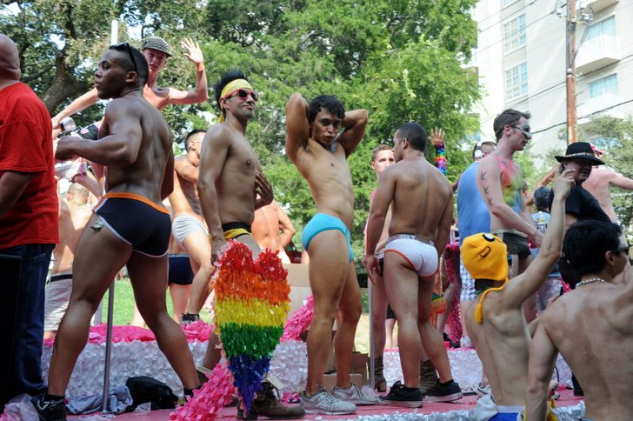
Stereotypes
What are some common stereotypes for?
South-East Asian men and women?
Caucasian men and women?
Gay men and women?

Slide 13
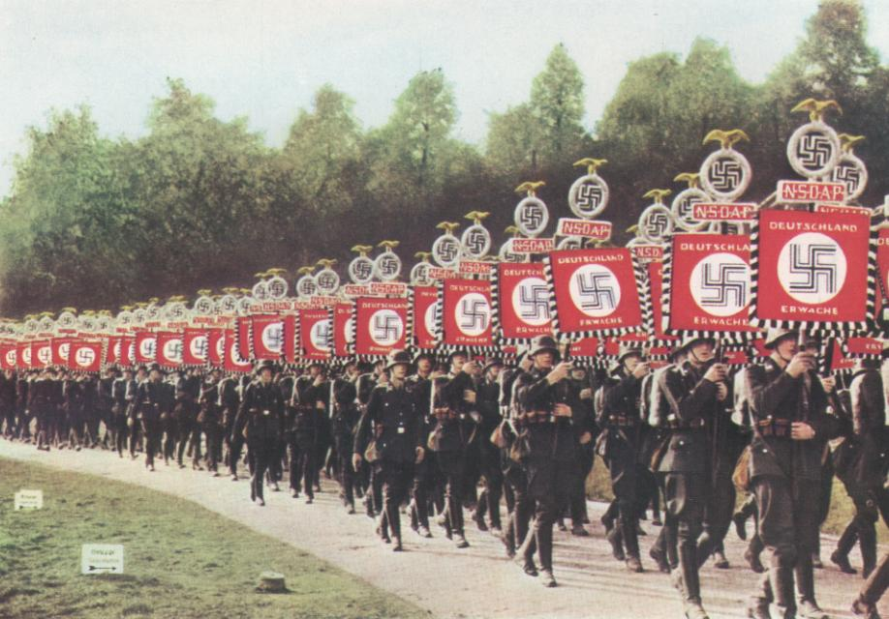
Scapegoat Theory
Scapegoat Theory
When something goes wrong people tend to try and find someone to blame the situation on.
Ingroup and Outgroup
Mentally drawing a circle that defines "us" (the ingroup) and "them" (the outgroup).
This leads to Ingroup Bias - the favoring of ones own group over others.
How do you think this concept relates to what happened in World War II?

Slide 14
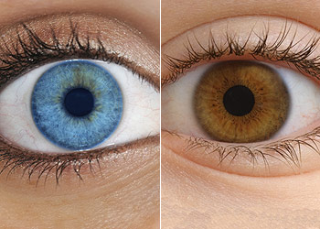
A Class Divided.
An elementary teacher did an experiment in which she divided her class into blue eyed and brown eyed people.
She informed her students that blue eyed people were not as intelligent as brown eyes.
Blue eyed children were not allowed to play with the brown eyed children.
What do you think happened?

Slide 15
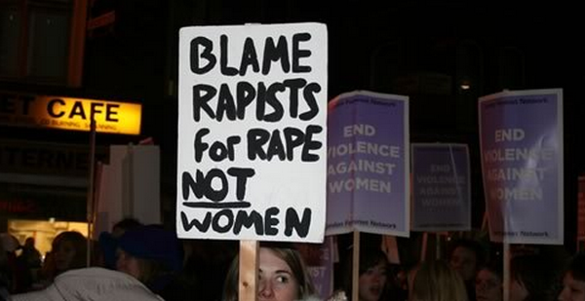
The Just World Phenomenon
A mistake that people make in assuming that the world is just, "people get what they deserve."
They believe that the good are rewarded and the bad are punished.
This can lead to blaming the victim in certain types of crimes.

Slide 16
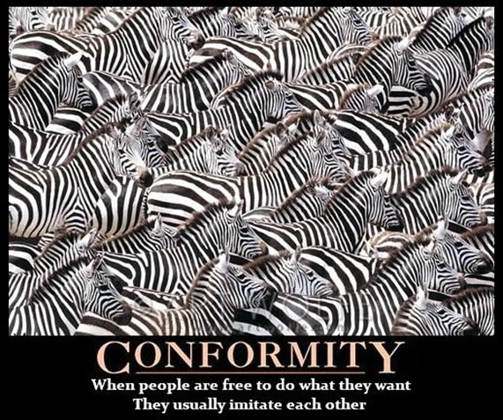
Conformity
Conformity is a type of social influence in which persons change their behavior as a result of real or imagined group pressure.
Do you feel pressure to conform to the fashion of the moment?

Slide 17
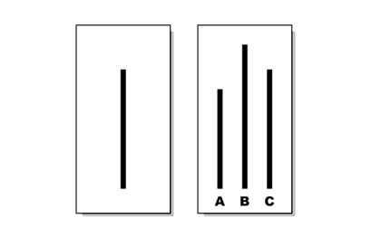
Asch and Conformity
Asch gave people a choice of three lines and asked which was the longest. He found that people would go along with the group answer even if it was not the longest line.
Asch found that 75% participants conformed to at least one wrong choice
subjects gave wrong answer (conformed) on 37% of the critical trials

Slide 18
Why do we conform?
Deautsch and Gerard (1955) identified two key reasons why people conform:
Informational influence happens when people change their behavior in order to be correct. In situations where we are unsure of the correct response, we often look to others who are better informed and more knowledgeable and use their lead as a guide for our own behaviors.
Normative influence stems from a desire to avoid social punishments (such as conforming to fit into a group) and gain rewards (such as behaving in a certain way in order to get people to like you).

Slide 19
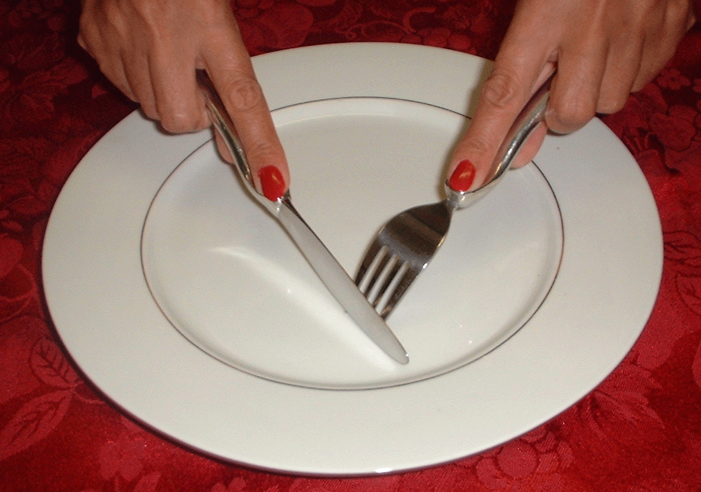
Norms
A social norm is an expected behavior that is adhered to by members of a group
Explicit norms: speed limits posted on a highway
Implicit norms: table manners at a formal dinner party
What happens if you
don’t follow norms for table manners?

Slide 20
Obedience to Authority
Obedience involves going along with a direct command from an authority figure
Factors that change obedience:
1) Perceived Power of the authority
2) Distance between the instructor and person
3) Assignment of responsibility: We are less likely to be obedient if we think we will be held responsible

Slide 21
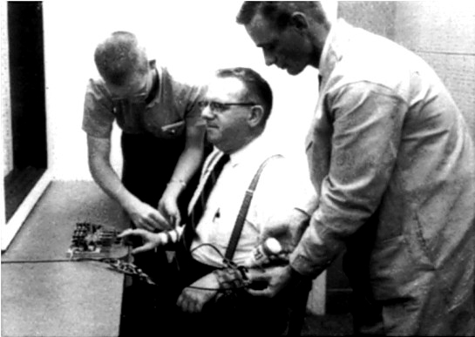
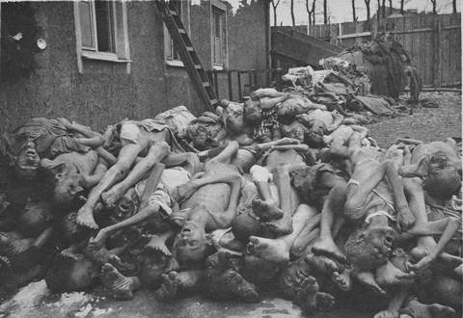
The Study of Obedience
In Milgram’s study, subjects were asked to deliver different voltages (0-450 volts) as a punishment to the “learner”
Milgram’s question was at what point would subjects refuse to deliver shock to another person?
What do you think happened, would people go to a lethal voltage?
How do you think this relates to what happened in WWII?

Slide 22
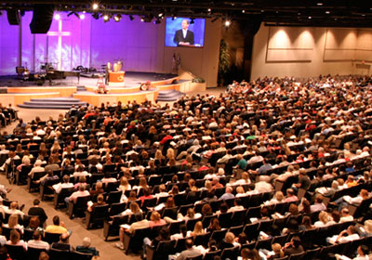
Group Processes
A group is two or more persons interacting with one another in such a way that each person influences and is influenced by each other person
Group mental processes:
1) Group polarization: the group decision is more risky than that of an individual
2) Groupthink: a mode of thinking that people engage in when part of a cohesive in-group. The group tends to make mistakes.
Can you think of examples of these
concepts?
If you attended a church that had extreme religious views – how would your views change?

Slide 23
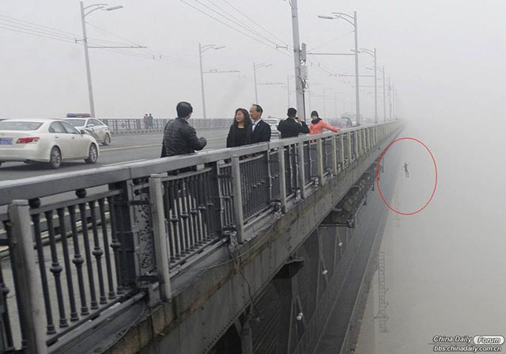
Altruism
Altruism refers to actions designed to help others. Three theories on why we are Altruistic:
1) Evolutionary theory suggests we are altruistic toward persons who share our genes --> fosters survival of our genes
2) Egoistic model: altruism is motivated by some anticipated gain
3) Empathy-altruism model: empathy leads to altruism
A man dives into to help someone who has
jumped off a bridge. Explain his behavior
using the theories.

Slide 24
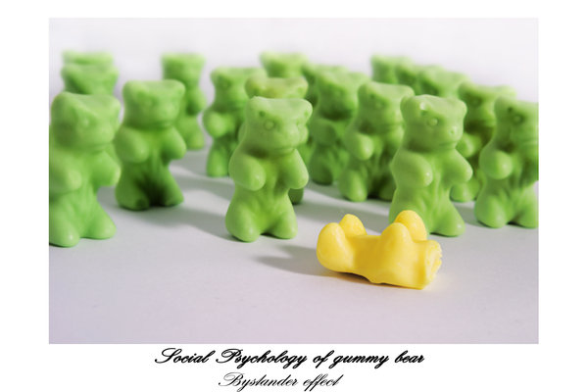
The Bystander Effect
People are more likely to help a person in need when there are less people around. When there are many people present, an individual may feel less responsible for helping the person in need.

