Slide 1

Perception
Basic Principles

Slide 2

Sensation
The process by which our sensory receptors and nervous system receive stimulus from the environment (stimulation of sense organs).
Example: Colour, shape and movement of a butterfly enter our eyes.

Slide 3
Perception
The process of organizing and interpreting sensory information, enabling us to recognize meaningful objects and events.
Seeing a butterfly seems to happen instantly but it is actually a very complex process, it only appears to happen quickly because our brains are so fast.

Slide 4
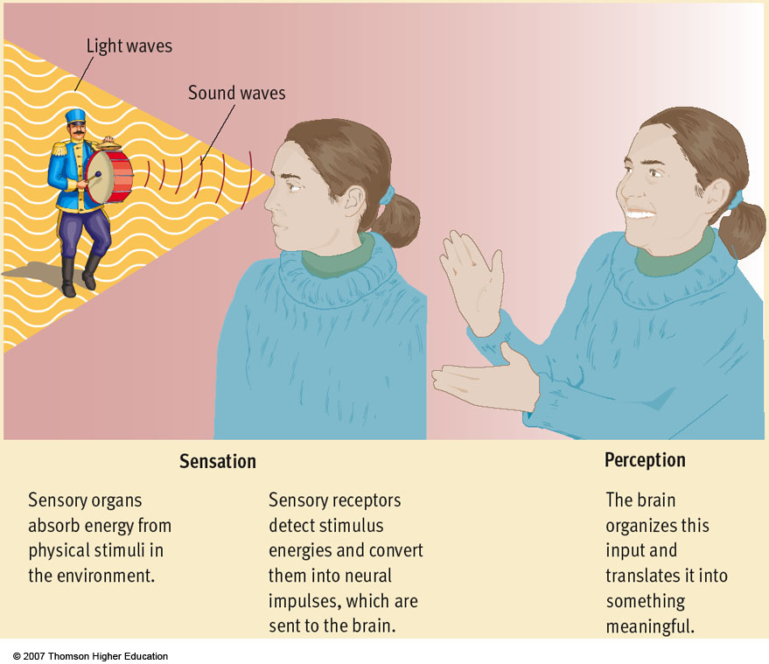

Slide 5

How many faces can you see? Is this sensation or perception?

Slide 6

What do you see?
What do you see?
One receives stimulation through the senses, but it is a meaningless array of black and white splotches. We struggle to impose some organization upon the meaningless array we are sensing. Our perception tells us that this is a picture of what?
Notes:
This illusion shows a dalmation sniffing around on the ground. The dog itself nor its surroundings can be identified by any one of the shapes in the image, but when taken as a whole the image of the dog can be recognised.

Slide 7
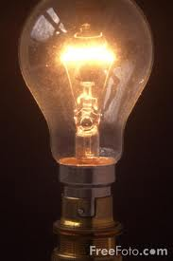
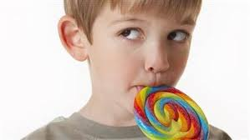

Pscychophysics
Psychophysics
relationship between physical characteristics of
stimuli and our psychological experience of them
Light Brightness
Sound Volume
Pressure Weight
Taste Sweetness

Slide 8
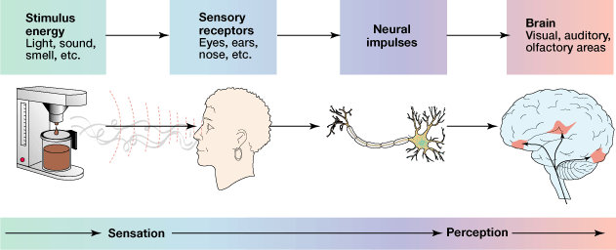
Transduction
The sensory process that converts physical energy, such as light or sound waves, into the form of neural messages. The brain only understands neural information.
Information goes from the senses to the thalamus, then to the various areas in the brain. For example, the visual cortex

Slide 9
Information goes from the senses to the thalamus, then to the various areas in the brain. For example, the visual or auditory cortex

Slide 10

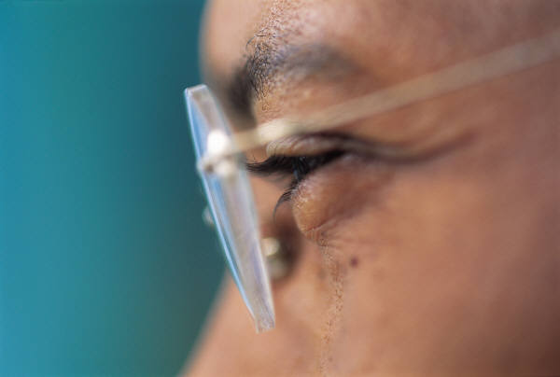
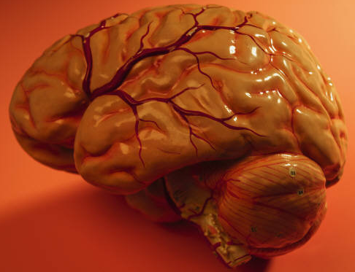
How does stimulation become perception?
First, physical stimulation (like light waves from the butterfly) are transduced by the eye, where information about the wavelength and the intensity of the light is coded into neural signals.
Second, the neural messages travel to the sensory cortex of the brain, where they become sensations of color, brightness, form, and movement.
Finally, the process of perception interprets these sensations by making connections with memories, expectations, emotions, and motives in other parts of the brain.
Stimulation
Transduction
Sensation
Perception
Light waves
Neural signals

Slide 11
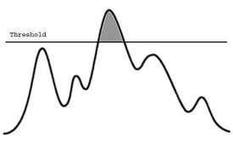
Thresholds
A threshold is an edge or a boundary
Each sensory system has a threshold level of energy that is required to activate that sense.
Absolute Threshold: the minimum amount of stimulation needed to detect a particular stimulus
Difference threshold (just noticeable difference): the minimum amount of difference needed to detect that two stimuli are not the same
Do you think that we all have the same thresholds? Can you think of people that have extremely perceptive senses?

Slide 12
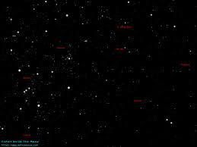
Absolute Threshold Examples
The dimmest visible star in the sky would be the best example of the absolute threshold for vision because it is just barely enough for you to see
The least amount of basil you can taste in the spaghetti sauce would be at the absolute threshold for taste
A person with normal vision in total darkness can detect the light of a single candle 30 miles away
If your hearing had a lower absolute threshold, you might constantly be distracted by the sound of blood pulsing near your ears
Why do we have thresholds? Why don’t we just hear and see everything that is there?

Slide 13
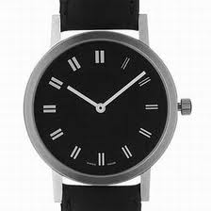
  Try it out at home:
  Set a wristwatch on a table in a quiet room. Walk away so you can no longer hear it. Walk slowly towards it until you can just detect it. If you stay there you will lose the sound then regain it…

Slide 14
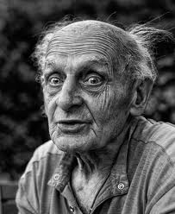
Absolute thresholds will change with age
Sensitivity to high pitched sounds declines with age.
Ex. “mosquito” ring tone to hide your phone from teachers OR to repel loitering teens and not older adults
Have you heard of teen buzz?

Slide 15
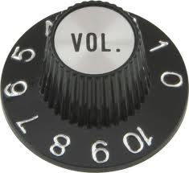
Difference Thresholds
Any smallest detectable change in a stimulus:
How much does the volume have to increase before you can tell that the music playing from your stereo has become louder
How much do the laces on your hiking boots need to be loosened so that they feel slightly less tight
Can you notice the difference when you turn the volume up one bar on the TV?

Slide 16
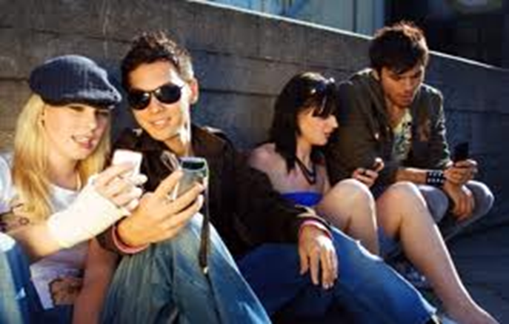
Signal Detection
How soon would you notice an incoming text?
Fairly quickly if
  You are expecting a particular message
  It is important that you detect it, and
  You are alert

Slide 17
Signal Detection Theory
  Predicts how and when we detect the presence of a faint stimulus (signal) amid background stimulation (noise)
  Assumes that there is no single absolute threshold
  Detection depends partly on person’s
      experience
      expectations
      motivation
      level of fatigue

Slide 18
Sub-Threshold
100
Subliminal
  When stimuli are below one’s absolute threshold for conscious awareness
Percentage
of correct
detections
75
50
Subliminal
stimuli
25
0
Low
Absolute
threshold
Medium
Intensity of stimulus

Slide 19

Sensory Adaptation
Sensory Adaptation (Habituation) is diminished sensitivity to constant and unchanging stimulation
One example of sensory adaptation occurs when you dive into a swimming pool filled with cold water. At first, the water seems frigid, but if you stay in for a while you will eventually get used to it…
Can you think of another example of habituation?
How about when driving on the highway? Why don’t we feel our underwear all day?

Slide 20
What if we could sense everything?
Go through and discuss what life would be like.
Sight
Hearing
Smell
Taste
THANKS GOODNESS FOR ABSOLUTE THRESHOLDS!!

Slide 21

Selective Attention
Selective attention is focusing conscious awareness on a particular stimulus to the exclusion of others
The best example of selective attention can be seen in E.G. Boring’s famous old women-young women drawing…
Can you hear someone talking to you when you are watching TV or reading a book

Slide 22
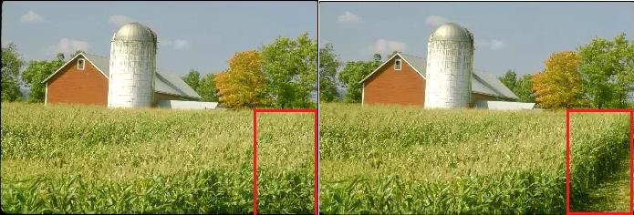
Change Blindness
When we are focused on one stimilus, we tend to not notice changes in other stimulus.

Slide 23
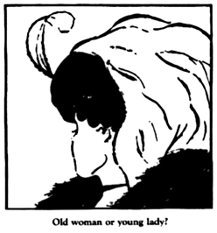

Slide 24

Color Blindness
“Color-blind” or color deficient people generally lack one of the three types of cones
Color deficient term is more accurate, because people with this condition are not blind to color but are just limited in the number of colors they can see.
Usually, these people lack either red cones or the green cones and have trouble telling the difference between the two
This condition is more common among men

Slide 25
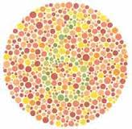
Color Deficiency continues…
Many times, the person with the color deficiency does not even realize a problem exists
What do you see? I
Don’t see anythging ☹

Slide 26
