Slide 1
Schizophrenia & Psychosis

Slide 2
Psychosis
The word "psychosis" is used to describe conditions that affect the mind, in which there has been some loss of contact with reality.
Hallucinations, delusions (false beliefs), paranoia and disorganized thoughts and speech are symptoms of psychosis. These symptoms can seem so real that often the person does not realize that they are experiencing psychosis.
What do you think the connection is between drugs and psychosis?

Slide 3
Who gets Psychosis?
Approximately 3% of people will experience a psychotic episode, a first episode usually occurs in adolescence or early adult life. Psychosis occurs across all cultures and affects males and females equally.
Being able to treat psychosis early is very important. A successful recovery leads to a healthy, productive future.
What period of stress and transitions might lead to a first psychotic break?

Slide 4
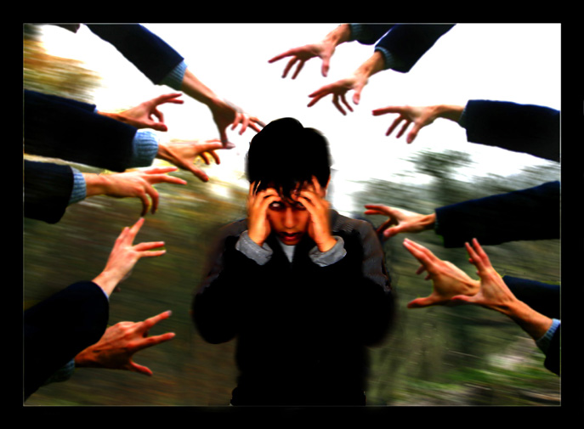
Schizophrenia
Schizophrenia is a severe mental disorder –- categorized as a psychotic illness –- that is usually treated with antipsychotic medications. It can involve breaks with reality
What is the connection between psychosis and schizophrenia?

Slide 5
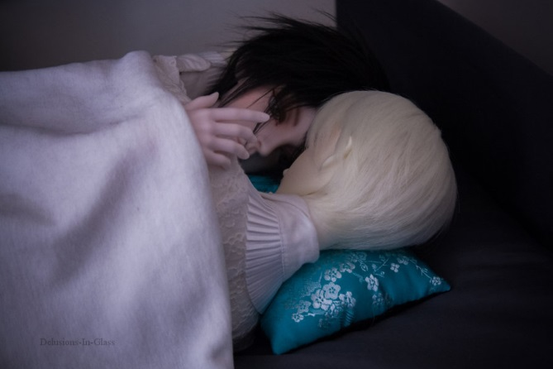
Signs and Symptoms: 1) Delusions
A delusion is a firmly-held idea that a person has despite clear and obvious evidence that it isn’t true. Delusions occur in more than 90% of those who have the disorder. Often, these delusions involve illogical or bizarre ideas or fantasies.
Can you predict some common delusions?

Slide 6
Delusions
Delusions of persecution – Belief that often involve bizarre ideas and plots (e.g. “Martians are trying to poison me with radioactive particles delivered through my tap water”).
Delusions of reference – An event is believed to have a special and personal meaning. For example, a person with schizophrenia might believe a billboard or a person on TV is sending a message meant specifically for them.
Delusions of grandeur – Belief that one is a famous or important figure, such as Jesus Christ or Napolean. Alternately, delusions of grandeur may involve the belief that one has unusual powers that no one else has (e.g. the ability to fly).
Delusions of control – Belief that one’s thoughts or actions are being controlled by outside, alien forces. Common delusions of control include thought broadcasting (“My private thoughts are being transmitted to others”), thought insertion (“Someone is planting thoughts in my head”), and thought withdrawal (“The CIA is robbing me of my thoughts”).

Slide 7
Signs and Symptoms: 2) Hallucinations
Hallucinations are sounds or other sensations experienced as real when they exist only in the person's mind.
While hallucinations can involve any of the five senses, auditory hallucinations (e.g. hearing voices or some other sound) are most common in schizophrenia.
Visual hallucinations are also relatively common
Have your ever hallucinated? When, what was it like?

Slide 8
Signs and Symptoms: 3)Disorganizations – Speech & behavior
Disorganized speech: Fragmented thinking is characteristic of schizophrenia. People with schizophrenia tend to have trouble concentrating and maintaining a train of thought. They may respond to queries with an unrelated answer, start sentences with one topic and end somewhere completely different, speak incoherently, or say illogical things.
What might the term “Word Salad” mean?

Slide 9
Disorganized Speech Types
* Loose associations – Rapidly shifting from topic to topic, with no connection between one thought and the next.
* Neologisms – Made-up words or phrases that only have meaning to the patient.
* Perseveration – Repetition of words and statements; saying the same thing over and over.
* Clang – Meaningless use of rhyming words (“I said the bread and read the shed and fed Ned at the head").
Have your heard someone who is mentally ill talking to themselves?
Did you notice any of the above?

Slide 10
Disorganized Behavior
Disorganized behavior: Schizophrenia causes impairments in a person’s ability to take care of him or herself, work, and interact with others. Disorganized behavior appears as:
* A decline in overall daily functioning
* Unpredictable or inappropriate emotional responses
* Behaviors that appear bizarre and have no purpose
* Lack of inhibition and impulse control
What might an inappropriate emotional response be?
How might someone with impulse control issue be dangerous?

Slide 11
4) Catatonic Movement
Disturbances in peoples movement
Can show as a dramatic reduction in activity – to the point of voluntary movement totally stopping (catatonic stupor)
OR dramatically increased movement (catatonic excitement)

Slide 12
5) Negative Symptoms
The so-called “negative” symptoms of schizophrenia refer to the absence of normal behaviors found in healthy individuals. Common negative symptoms of schizophrenia include:
Lack of emotional expression –Inexpressive face, including a flat voice, lack of eye contact, and blank or restricted facial expressions.

Slide 13
Negative Symptoms
Lack of interest or enthusiasm – Problems with motivation; lack of self-care.
Seeming lack of interest in the world – Apparent unawareness of the environment; social withdrawal.
Speech difficulties and abnormalities – Inability to carry a conversation; short and sometimes disconnected replies to questions; speaking in monotone.
Why would someone lack interest in the outside world?
Why would they be unable to carry on a conversation?

