Slide 1
Personality Disorders
Extreme patterns of thinking, feeling, and behaving that are different from a person’s culture

Slide 2
Types of PD’s
Begin early in life and generally do not change
Cause significant problems in life and personal distress
Cluster A = suspicious
Cluster B = emotional and
impulsive
Cluster C = anxious

Slide 3
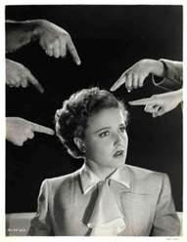
Suspicious: Paranoid
suspicious, feel others are against them
sensitive to rejection and hold grudges
see hidden messages in other's comments
appear cold and serious
How might this person react to being
randomly pulled over by the police?
Fictional Character:

Slide 4
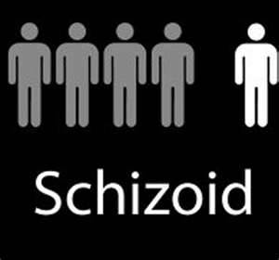
Suspicious: Schizoid
emotionally cold
prefer own company, loners
no need for friends, sex
have fantasy world
Question: Why wouldn't this
person feel lonely?
Fictional Character:

Slide 5
Suspicious: Schizotypal
odd ideas, magical thinking
difficulties with thinking
lack of emotion.
may see or hear strange things
a distant cousin of schizophrenia
Question: What would you
guess that magical thinking is?
Fictional Character:

Slide 6
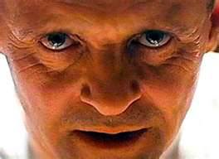
Emotional: AntiSocial
no care for feelings of other
easily frustrated and aggressive
avoid intimacy – relationship are only for self gain.
Psychopathy
lack of feeling for others - no remorse
use and manipulate other people
Human Predators
No conscience
early behavior problems
Questions: What early behavioral
Problems might there be?

Slide 7
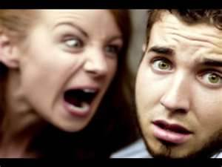
Emotional: Borderline
emotionally unstable
impulsive
low self-worth
everything is “good” or “bad”
intense, unstable relationships
self-harm
Question: Why do you think this type of person is prone to slashing?
Fictional Character:

Slide 8
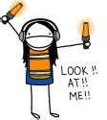
Emotional: Histrionic
over dramatic and self-centred
show strong emotions which change and don’t last
crave new things, excitement.
attention seeking- seeks reassurance
very seductive - "the life of the party"
Fictional Character:

Slide 9
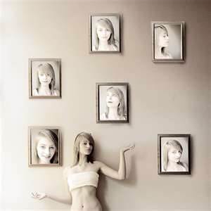
Emotional: Narcissistic
strong sense of self-importance
dream of power, success
crave attention of others, no warm feelings in return
exploits and manipulates others
exaggerates/lies about accomplishments
sensitive to criticism
Fictional Character:

Slide 10
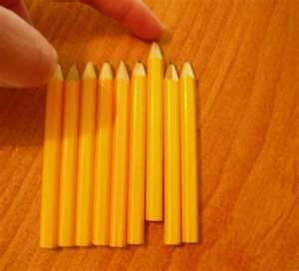
Anxious: Obsessive-Compulsive
worry, doubt
perfectionist - rigid - workaholic
worry about doing wrong thing
high moral standards - judgmental of others
obsessed with trivial details
humorless
Question: Why would this person be so quick to judge others?
Fictional Character:

Slide 11
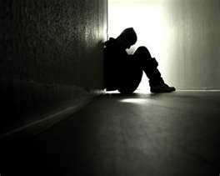
Anxious: Avoidant
anxious, tense
insecure, feelings of inferiority
have to be liked, accepted
sensitive to criticism.
scared of social situations, but lonely
Question: What kind of early trauma might have resulted in this disorder?
Fictional Character:

Slide 12
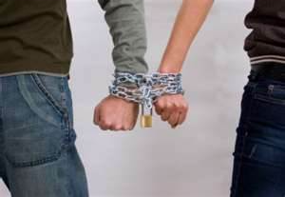
Anxious: Dependent
passive - rely on others to make decisions
feel incompetent
feel abandoned by others
submissive, clingy behavior
fear of separation
Why might this type of person have problems with relationships?
Fictional Character:

