Slide 1
The Hormones related to Hunger
Ghrelin: The “________ hormone" Ghrelin is one of the main hormones to stimulate _______. Ghrelin levels __________ before meals and ________ after meals
Leptin: It is produced by the _______or________tissue in the body. Leptin induces ________ or a feeling of _________ after a meal. When the leptin level is ______, hunger is _________.
Insulin: Insulin is a hormone made by the __________ that allows your body to use _______(_______) from _______________ in the food that you eat for energy or to store ______ for future use. Insulin helps keeps your blood sugar level from getting too high (____________) or too low (______________).
Glucose activates Insulin, Leptin and suppresses Ghrelin
Fructose DOES NOT activate Insulin, DOES NOT suppress Ghrelin and BLOCKS Leptin

Slide 2
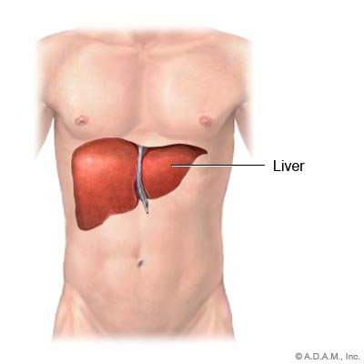
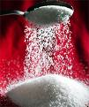
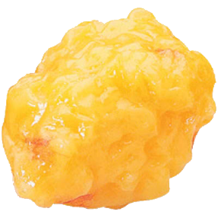
What is SUGAR really doing to your BODY
___% to Body
For energy
___Calories
__% Glucose
___% to Liver
___Calories
Calories
___ Calories
Does NOT block ______
____ % becomes Body FAT
100 Calories of Sugar
(__g = 1 tsp =___Calories)
___% Fructose
___Calories
___% to Liver
= POISON
___Calories
___Calories
Blocks _______:
the hormone that makes you ________and ____ storing fat
___% of Calories Metabolizes into FAT

Slide 3
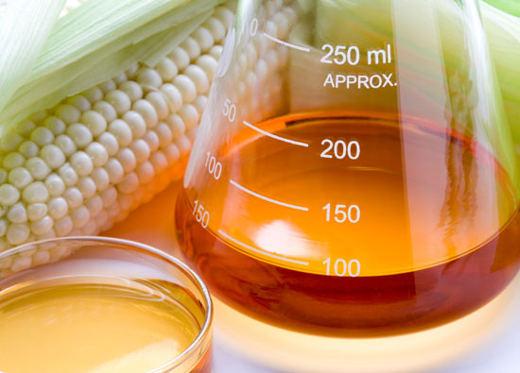
What is HFCS really doing to your BODY
__% to Body for energy
__ Calories
__% Glucose
__% to Liver
__Calories
__Calories
Does NOT block ______
__ Calories
__% becomes Body FAT
__% Fructose
__ Calories
___% to Liver
= POISON
100 Calories of High Fructose Corn Syrup (HFCS)
___ Calories
__ Calories
Blocks ______:
the hormone that makes you _______and ____ storing fat
___% of Calories Metabolizes into FAT

