Slide 1
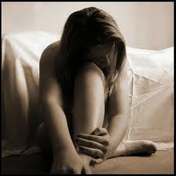
Mood Disorders
Mood disorders are characterized by extreme disturbances in emotional states

Slide 2
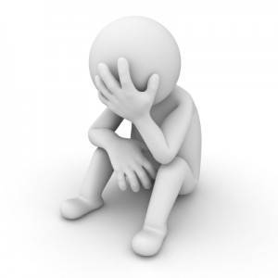
Symptoms
Mood change or disturbance
Irritability
Changes in eating habits
Sleep problems
Difficulty concentrating
Feelings of worthlessness
Fatigue or loss of energy
Why do we eat less or more when we are depressed?
Why do we have difficulty concentrating when we are depressed?

Slide 3
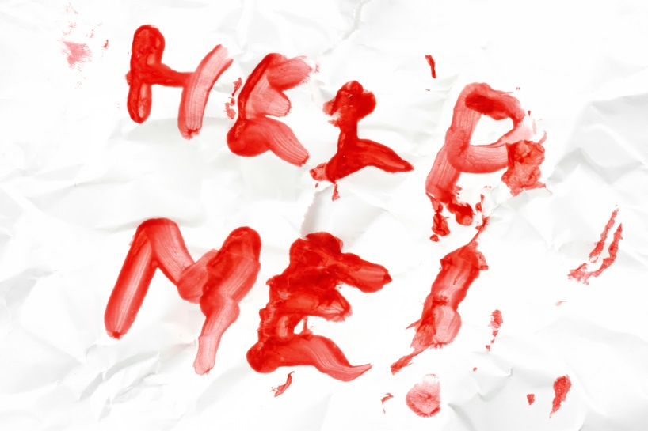
Cutting/Self-Harm
More common amongst women.
Estimated 4% of the population self-injures.
A way to escape negative emotion and externalise pain.
It can become an addictive escape from emotion and escalate.
What other ways might people self-harm?

Slide 4
Suicide
One of the leading causes of death during the teenage years.
Can be preceded by suicidal ideation.
Hospitalization allows for a safe place for treatment to occur.
May be related to the concept of learned helplessness.
Always take suicide threats seriously.
Why are suicide rates so high during the teen years?

Slide 5
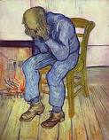
Major Depression
Extreme mood disorder in which the person experiences depression not otherwise explained by outside circumstances
Feels like an inescapable weight
Can lead to suicide
Diminished interest in activities
What things might people stop caring about? Brainstorm a list.

Slide 6
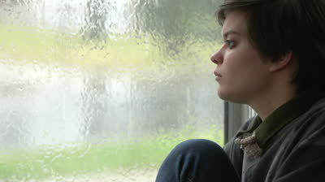
Dysthymia
Chronically depressed mood that occurs for most of the day, more days than not, for at least two years
Lasts longer, but is less severe than major depression
Sometimes called the “common cold” of mental illness
Should Dysthymia be medicated?

Slide 7
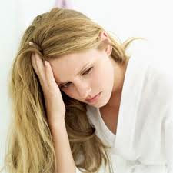
Gender Differences and Depression
Two out of every three people who are depressed are women.
Before the age of 11, girls and boys have the same rates of depression. By age 18 girls have twice the depression rate of boys.
Any theories? Why the difference?

Slide 8
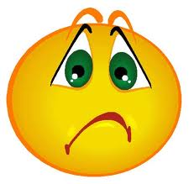
Bipolar Disorder
Bipolar Disorder – previously known as manic depressive disorder – is mood disorder in which the person alternates between the hopelessness of depression and the overexcited and unreasonably optimistic state of mania
Also known as manic-depression

Slide 9
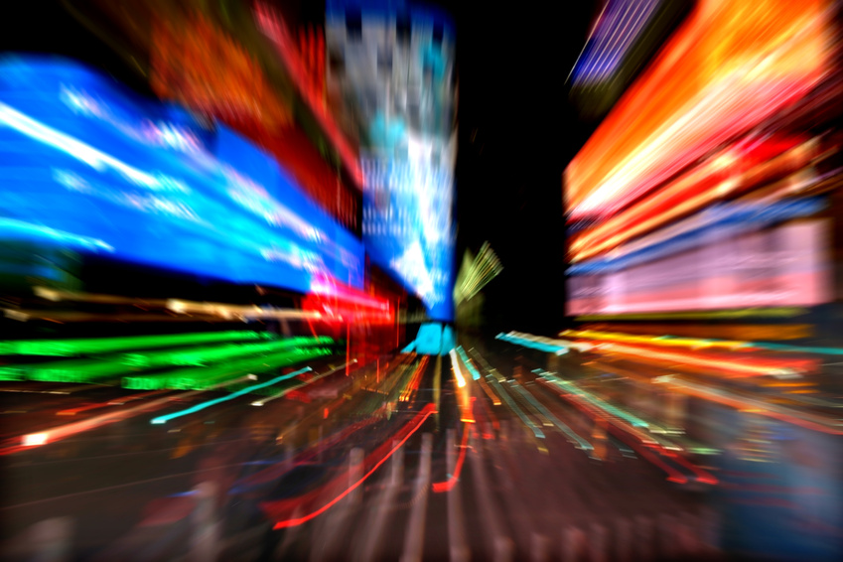
Mania
It’s good to be optimistic, but these manic phases are well beyond normal.
During mania, a person may go long periods without sleeping, may experience racing thoughts, speek rapidly, may be easily distracted, may set impossible goals and may eventually go into psychosis.
What do mean when we call someone a maniac?

Slide 10
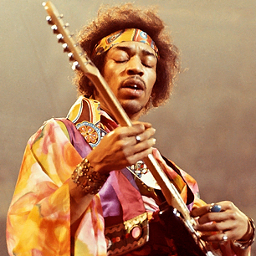
Mania: Artists
Russel Brand, Kurt Cobain, Mel Gibson, Freidrich Nietzche, Sinead O’Connor, Edgar Allen Poe, Britney Spears, Vincent Van Gogh, Brain Wilson, Amy Winehouse, Virgina Woolfe, Ben Stiller, Robin Williams, Francis Ford Coppola, Jimi Hendrix, Tom Waits, Mark Twain, Charlie Sheen.
Why do you think that Bipolar Disorder is associated w/ creative work?

Slide 11
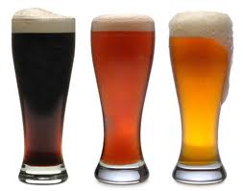
Self-Medication
It is common for people with Mood Disorders to self- medicate.

Slide 12
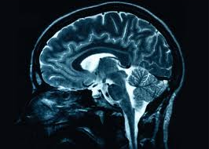
Causes
Heredity – many disorders run in families, and mood disorders are no exception
Brain function – depressed people have depressed brains. The two neurotransmitters that are most important for depression are serotinin and norepinephrine, which are lacking during times of depression.
Can depression really be just chemicals in our brain?

Slide 13
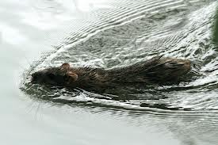
Causes
Learned helplessness – people develop a sense of helplessness when subjected to unpleasant events over which they have little or no control
Attributions – when things go wrong, we try to explain them. It turns out that depressed people are likely to blame internal characteristics rather than external influences.
What’s the difference between the two rats?

Slide 14
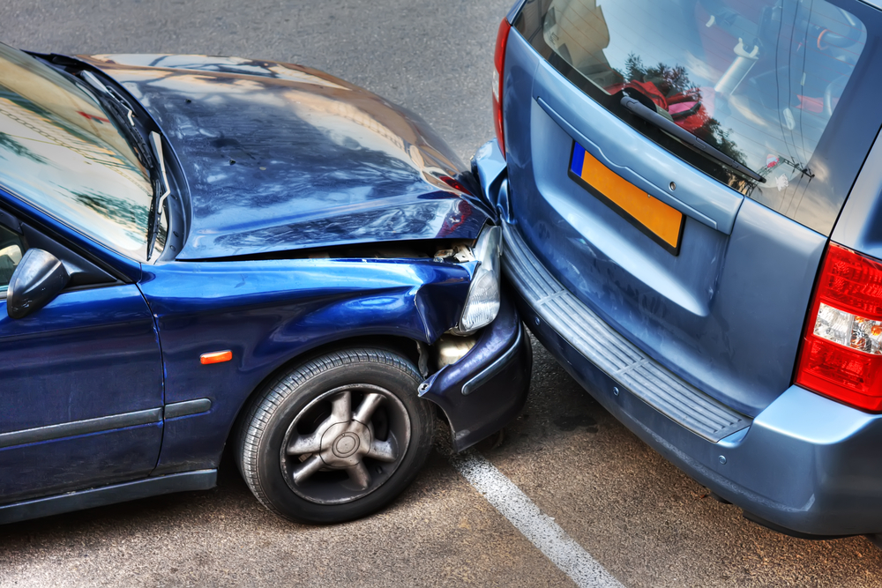
Attributions
You were in a car accident. Think of two ways to explain it.
Situational:
Dispositional:

Slide 15
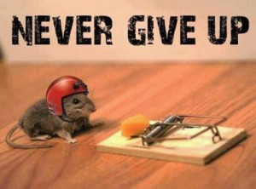
Learned Helplessness
Can you think of a time when you have just given up?
Share with a partner.

