Slide 1
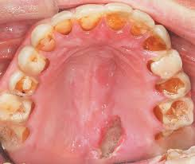
Eating Disorders

Slide 2
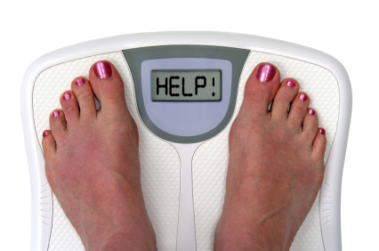
What Is An Eating Disorder?
Generally, an Eating Disorder any of a range of psychological disorders characterized by abnormal eating habits and behaviors.
An eating disorder is when a person experiences severe disturbances in eating behavior, such as extreme reduction of food intake or overeating, or feelings of intense distress or concern about body weight or shape.
People with eating disorders are usually SECRETIVE about their eating, purging or lack of eating.
What might you consider an
Abnormal eating behavior?

Slide 3
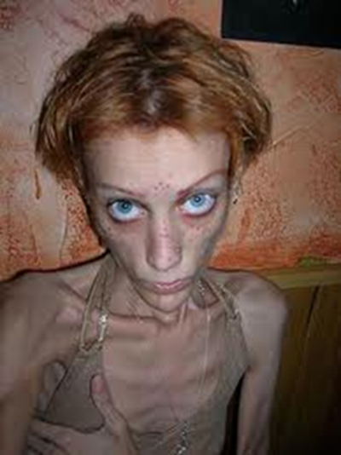
Anorexia Nervosa
Anorexia is the loss of appetite for food as a medical condition. As an emotional disorder, is it characterized by an obsessive want to lose weight by refusing to eat.
A very complex eating disorder, Anorexia has 3 key characteristics
Refusal to maintain a normal body weight
Intense fear of gaining weight
Body dysmorphia (distorted body image)
Do you think that someone with Anorexis thinks that
They still need to lose weight? Do they really see the fat?

Slide 4
Sings and Symptoms
Dramatic weight loss.
Denial of being underweight.
Obsession with calories, fat, grams, carbs, etc.
Often making excuses as to why the person is not eating.
What kind of excuses could
someone make for not eating or avoiding situations where eating is involved?

Slide 5
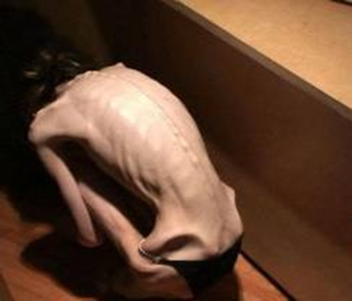
Causes
Some research suggests a genetic predisposition to Anorexia.
Brain chemistry plays a significant role as well.
An individual may experience decreased self-esteem or self-control because of pre-disposing factors and use dieting or weight loss to gain a sense of control.
How does would someone with Anorexia
feel a sense of control in their life?

Slide 6
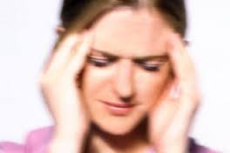
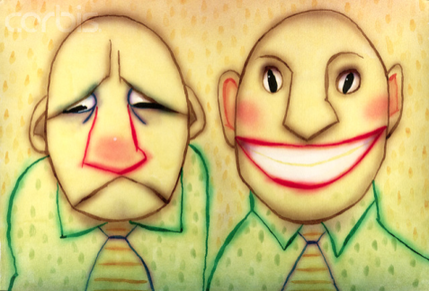
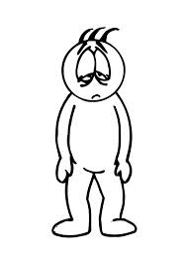
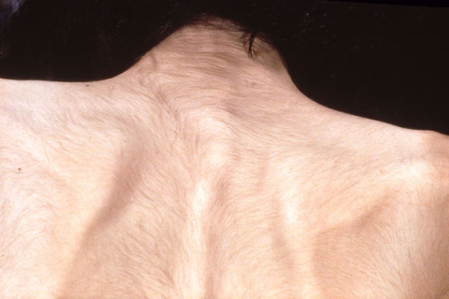
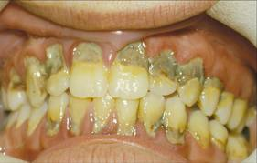
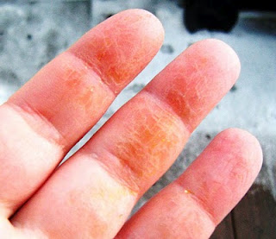
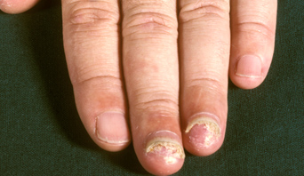
Physical and Mental Effects
Dizziness, Headaches and Fainting
Mood Swings
Poor Memory
Tiredness/Fatigue
Small Black Hairs over Body and Face
Tooth and Gum Decay
How are these symptoms
related to a lack of nutrition?
Yellowing Skin
Brittle, Breaking Nails

Slide 7
ProAnna
There are a number of internet sights that promote Annorexia
They are a place where people can share tips on not eating.
A number of places have tried to ban them and make them illegal.
What do you think?

Slide 8
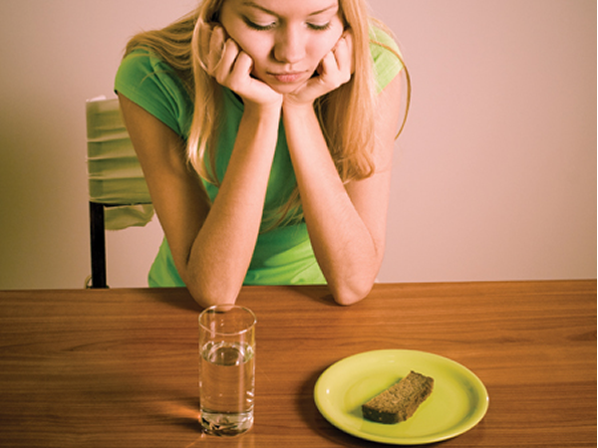
Warning Signs
If you suspect that your friend may be developing Anorexia, what kind of clues could you look for? Brainstorm a list.

Slide 9
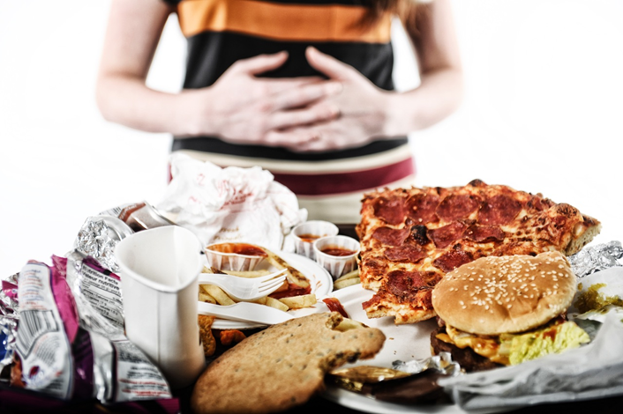
Bulimia Nervosa
An overeating disorder followed by a vicious purging cycle. A compulsion to overeat followed by intense feelings of guilt and depression thus beginning the cycle of forced sickness, over exercising, or fasting.
People with Bulimia tend to be of average weight.
Do you ever feel guilty after eating
And have the desire to “purge”?

Slide 10
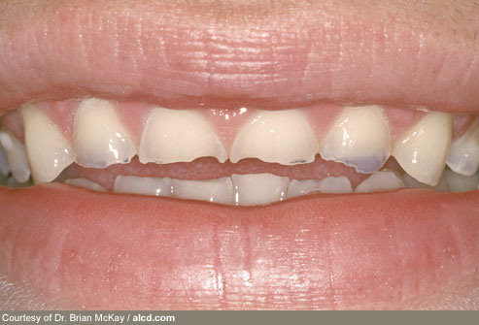
Causes
Genes, hormones and brain chemicals similar to those found in Anorexia sufferers contribute.
Like Anorexia, Bulimia stems from an obsession to lose weight.
Unlike Anorexia, Bulimics are more focused on self-image than control.
Why are people with Bulimia of
An average weight and not thin?

Slide 11
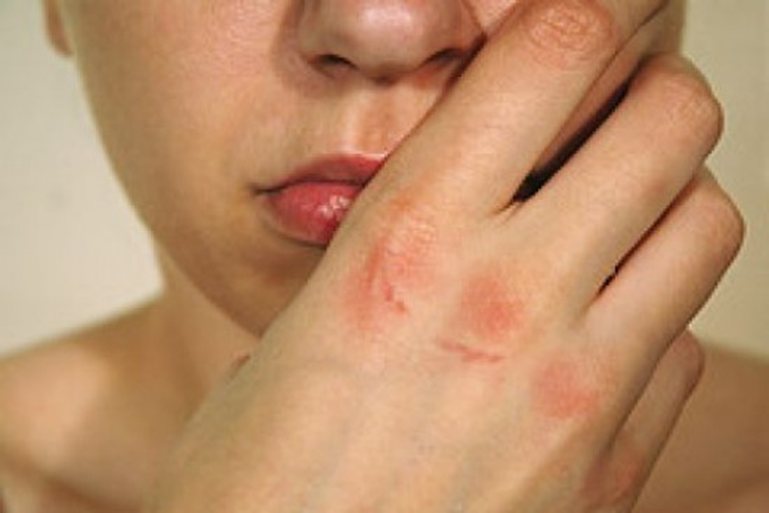
Physical and Mental Effects
Inability to sleep
Infertility
Internal bleeding
Swelling and scarring in the throat and mouth
Swelling and scarring on fingers and hands
Depression
Anxiety
Heart Attacks
Ultimately, death.

Slide 12
The Cycle
Strict Diet and Exercise
Feelings of Depression, Guilt, Disgust and Self Hatred
Binging over
Eating mass amounts
In a short period of time
Purging excessive exercise, forced sickness and fasting.
How could you break the cycle? How would you treat someone with Bulimia?

Slide 13
Warning Signs
If you suspect that your friend may be developing Anorexia, what kind of clues could you look for? Brainstorm a list.

Slide 14
Statistics
– One in 100 American women suffer from anorexia. Three in 100 women suffer from bulimia. That makes 3/100.
– Women are much more likely than males to develop an eating disorder, but men can have eating disorders (and it is increasing).
– Anorexia nervosa has the highest early death rate of any mental illness, up to 20 percent.
– Most people with eating disorders never receive mental health care.
– Almost 50% of people with eating disorders meet the criteria for depression.
- As many as 10% of college women suffer from a clinical or nearly clinical eating disorder, including 5.1% who suffer from bulimia nervosa
Which fact do you find surprising and/or interesting?

Slide 15
Helping your Friends
What warning signs could you look for for the following disorders?
Cutting
Psychosis
Mania
Anorexia
Bulimia
What should you do if you see some of the warning signs?

