Slide 1
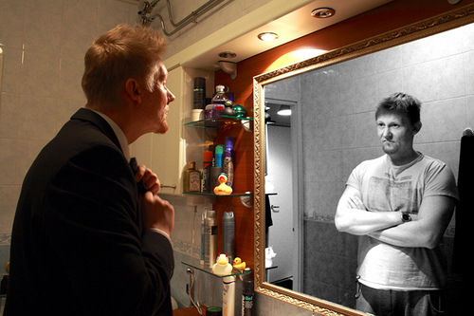
Dissociative, Somatoform and Factitious Disorders

Slide 2
Dissociative, Somatoform and Factitious Disorders
The dissociative and somatoform disorders were historically linked with anxiety disorders as forms of neuroses. Anxiety is expressed directly in different forms in the anxiety disorders, but its role in the dissociative and somatoform disorders is inferred.

Slide 3
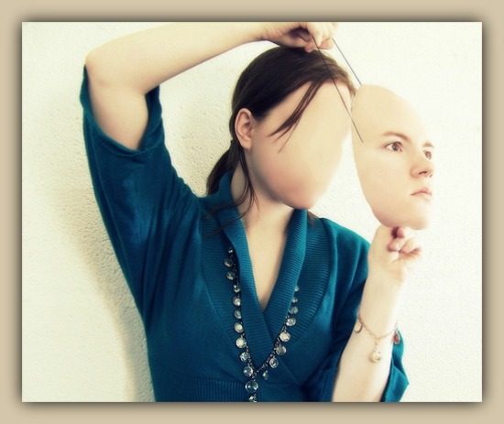
Dissociative Disorders
Dissociative disorders involve changes or disturbances in identity, memory, or consciousness that affect the ability to maintain an integrated sense of self

Slide 4
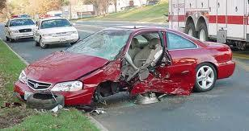
Dissociative Amnesia
This disorder is characterized by a blocking out of critical personal information, usually of a traumatic or stressful nature.
Localized amnesia is present in an individual who has no memory of specific events that took place, usually traumatic. The loss of memory is localized with a specific window of time. For example, a survivor of a car wreck who has no memory of the experience until two days later is experiencing localized amnesia. fferent ways that memory can be interrupted.

Slide 5
Dissociative Amnesia
Selective amnesia happens when a person can recall only small parts of events that took place in a defined period of time. For example, an abuse victim may recall only some parts of the series of events around the abuse. They may forget specific people and events.

Slide 6
Dissociative Amnesia
Generalized amnesia is diagnosed when a person's amnesia encompasses his or her entire life.
Question: Why do you think that our brain blocks out traumatic information? What is the purpose?

Slide 7
Dissociative Fugue
It is a rare disorder. An individual with dissociative fugue suddenly and unexpectedly takes physical leave of his or her surroundings and sets off on a journey of some kind. These journeys can last hours, or even several days or months.
Individuals experiencing a dissociative fugue have traveled over thousands of miles. An individual in a fugue state is unaware of or confused about his identity, and in some cases will assume a new identity
Question: Why do you think that people travel when they are in a Dissociative Fugue? What is the purpose?

Slide 8
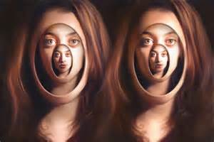
Dissociative Identity Disorder (DID )
It has been known as multiple personality disorder, and is the most famous of the dissociative disorders. An individual suffering from DID has more than one distinct identity or personality state that surfaces in the individual on a recurring basis. This disorder is also marked by differences in memory which vary with the individual's alters, or other personalities.
Question: Do you think that this disorder is "real"? Are there really multiple people in there?

Slide 9
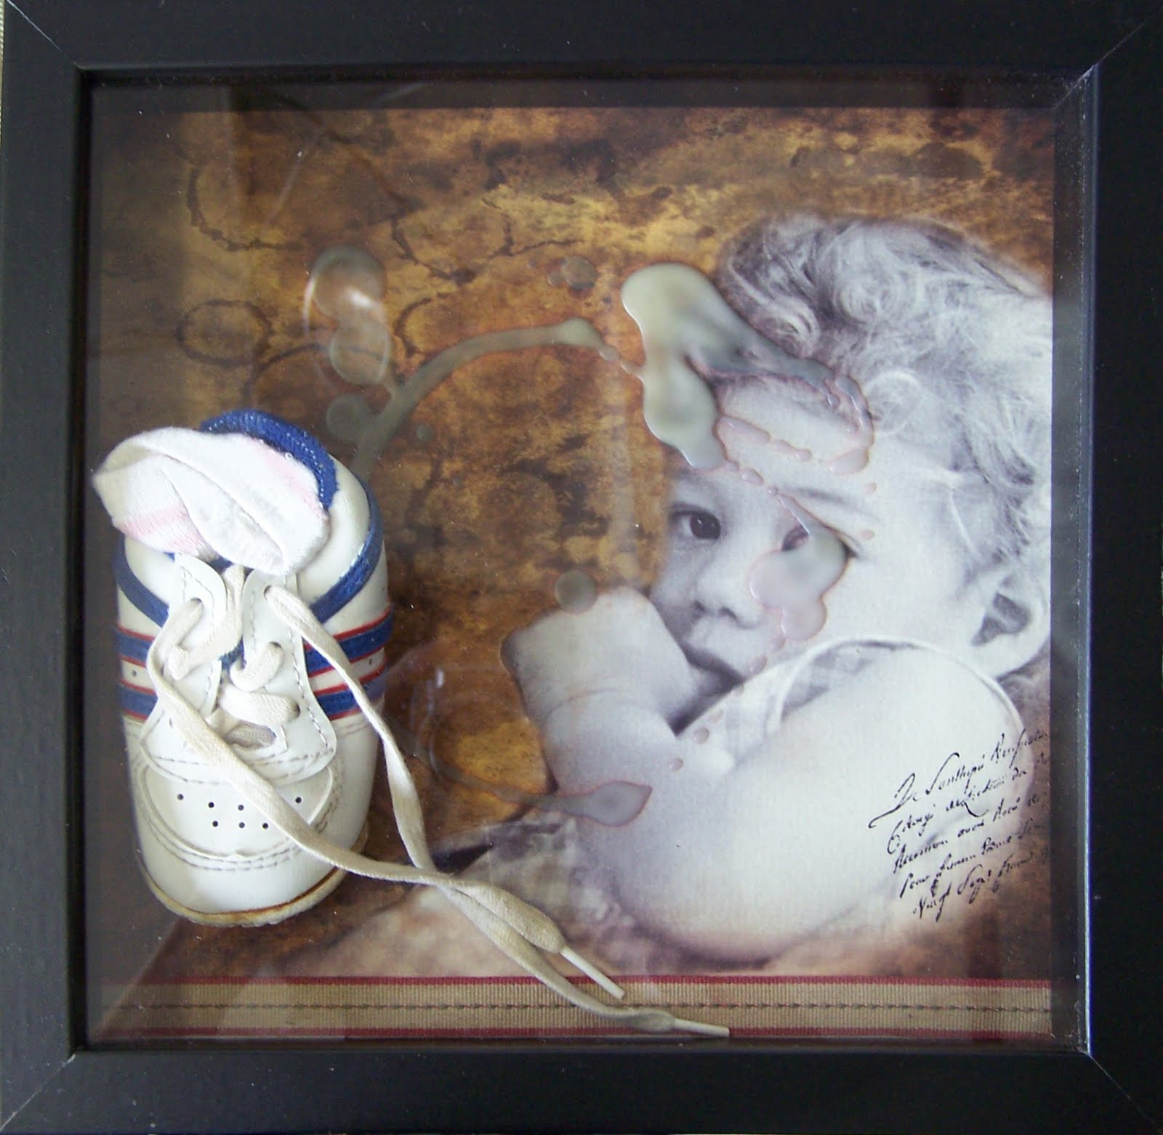
Dissociative Identity Disorder (DID )
DID has been linked to childhood abuse in many cases.
A common factor is children learning to “leave” their bodies
Alters do not share memories. One alter will not know what has been happening when they surface.
Different alters seem to surface in stressful situations in an attempt to deal with them.

Slide 10
Depersonalization Disorder
It is marked by a feeling of detachment or distance from one's own experience, body, or self.
Of the dissociative disorders, depersonalization is the one most easily identified with by the general public; one can easily relate to feeling as they in a dream, or being spaced out. Feeling out of control of one's actions and movements is something that people describe when intoxicated.

Slide 11
Depersonalization Disorder
An individual with depersonalization disorder has this experience so frequently and so severely that it interrupts his or her functioning and experience. A person's experience with depersonalization can be so severe that he or she believes the external world is unreal or distorted.
Question: Do you ever get the feeling that things aren't real? That something is out of place? Can you share a time that this has happened?

Slide 12
Somatoform Disorders
In somatoform disorders, there are physical complaints that cannot be accounted for by organic causes. Thus the symptoms are theorized to reflect psychological rather than biological factors.
Question: When you are stressed – do you have a physical reaction?

Slide 13
Hypochondriasis
Individuals with this disorder (“hypochondriacs”) are preoccupied with the belief or fear that they have a serious medical condition.
Their belief or fear is triggered by their own misinterpretation of their physical symptoms or bodily functions (e.g. they have occasional headaches and fear they have a brain tumor).
Question: Do you know someone like this? How do you think you think someone might be treated for this?

Slide 14
Body Dysmorphic Disorder
Individuals with this disorder become extremely preoccupied with and distressed about one or more imagined or actual (but minor) physical flaws
Example: someone with a small scar on her hand always wears gloves or keeps her hand hidden from others.
Question: How might someone develop this disorder? Any theories?

Slide 15
Conversion Disorder
Individuals with this disorder have symptoms or difficulties with their senses (e.g. blindness, deafness) or their motor functioning (e.g. Coughing, difficulties swallowing, weakness in a specific area).
Their symptoms suggest a biological cause but no such cause can be found.
They usually experience stress that is believed to be associated with the development of the disorder.
Question: How could this be possible? Can your brain really just shut off your vision because it wants to?

Slide 16
Factitious Disorders
A factitious disorder is a condition in which a person acts as if they have an illness by deliberately producing, feigning, or exaggerating symptoms.

Slide 17
Münchausen Syndrome
The affected person exaggerates or creates symptoms of illnesses in themselves to gain investigation, treatment, attention, sympathy, and comfort from medical personnel.
People suffering from Münchausen's syndrome may be highly knowledgeable medicine and are able to produce symptoms that result in lengthy and costly hospitals says and surgery
Question: Why? Why would someone want to do this?

Slide 18
Münchausen Syndrome by Proxy
The adult ensures that his or her child will experience some medical affliction, therefore compelling the child to suffer treatment for a significant portion of their youth in hospitals.
Question: This is pretty horrible. If you were a doctor, how might you try to catch these situations?

Slide 19
Case Studies
1. Mary believes that she has a serious illness. She spends her days on webMD doing research on what she thinks she has. The doctor sends her for tests every week but she never seems to have any actual health problems. Eventually, her doctor sends her to a psychiatrist to see if there might a psychological root to her issues.

Slide 20
2. One day Mark walked out of the garage that he was working in. He wandered around the city for hours in a confused state. Then, he got on a bus and left the city. He started a new life in a different city and forgot who he used to be. Eventually, his memories started to come back and he decides to visit a psychiatrist to figure out where these memories are coming from.

Slide 21
3. Jessica shows up at the emergency room each weekend and the doctors have gotten to know her. She claims to have many diseases but there are no diagnosis listed on her medical files. She complains of headaches, shooting pain, and a number of other symptoms. Finally, the doctors decide it would be best to send her to a psychiatrist for diagnosis.

Slide 22
4. Mark first had a pain in his wrist when he was very young. Despite having it tested, no problem is ever found. Mark continues to have the pain for the rest of his life. He decides to visit a psychiatrist.

Slide 23
5. Sarah frequently looses periods of time where she cannot remember what happened to her. Her friends tell her that she seems to change suddenly and act very differently. She decides to visit a psychiatrist to figure out what is going on.

Slide 24
6. Mark repeatedly gets the feeling that somehow things are not real. The feeling comes over him many times a day and he doesn't know what is going on. He will be driving and be overpowered with the feeling. It gets to the point where he can't stand it any more and decides to go to a psychiatrist to possibly get some medication.

Slide 25
7. One day Chris went deaf. He was taken to the hospital but no biological reason for his deafness could be found. After weeks of testing, he was discharged and sent to a psychiatrist.

Slide 26
8. One day Darcy was standing at a bus stop. An old friend came up to him and shook his hand. Darcy couldn't remember who the person was. All of a sudden Darcy couldn't remember his name or why he had been waiting for the bus. His friend walked him to the hospital where he was taken to the psychiatric wing.

