Slide 1
Cults and Brainwashing
Using the tools of Social Psychology to Manipulate

Slide 2
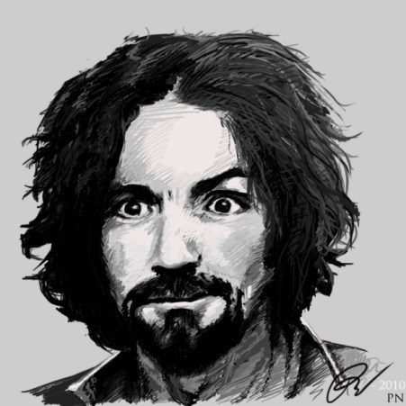
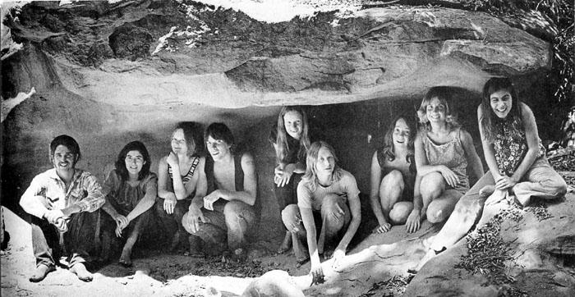
The Manson Family
Lead by Charles Manson
Lived on a Ranch together
Charles Manson believed he was interpreting special meanings from The Beatles; The White Album.
The Family invaded a house in the Hollywood Hills and killed a number of people.

Slide 3
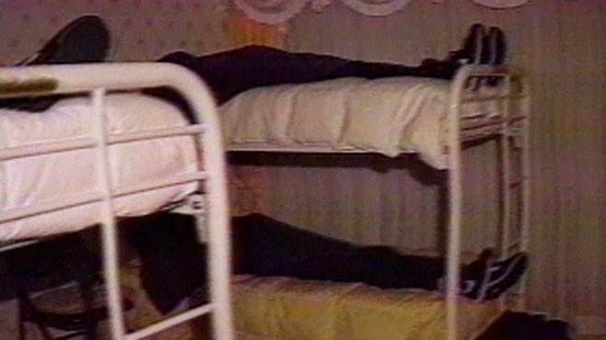
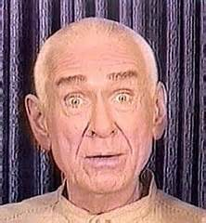
Heaven’s Gate
Lived in a large house in San Diego
Committed to a celebate life
38 members committed mass suicide. The believed that they would be reborn without gender.
The suicides were conducted in shifts – with living members cleaning up after the dead.

Slide 4
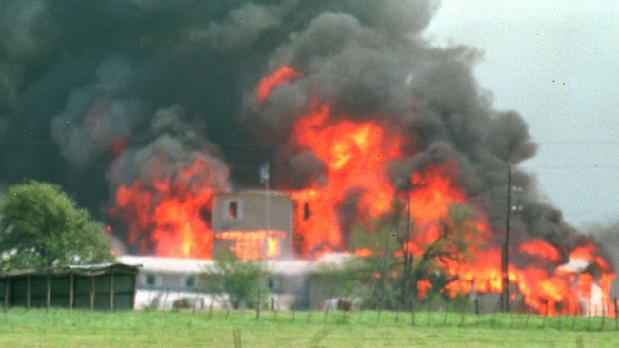
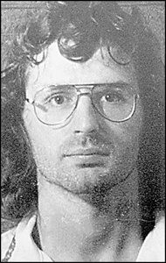
Branch of Davidians
A doomsday cult
Stockpiled weapons on a ranch in Waco, Texas
The FBI raided the ranch and 79 people were, killed; including 29 children
Many had taken their lives before the end of the standoff.

Slide 5
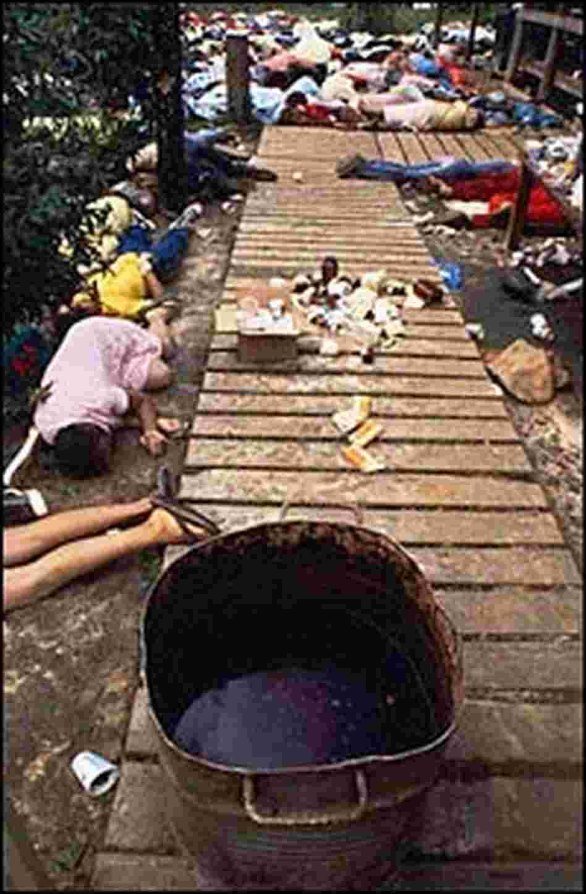
Jonestown
The cults was originally in the United states but fled to the jungles of Guyana to avoid American authorities.
When they heard that the compound was going to be raided, they prepared vats of grade kool aid with cyanide.
912 people drank the kool aid and died. The largest ever cult mass suicide.
Parents fed their children the kool aid.

Slide 6
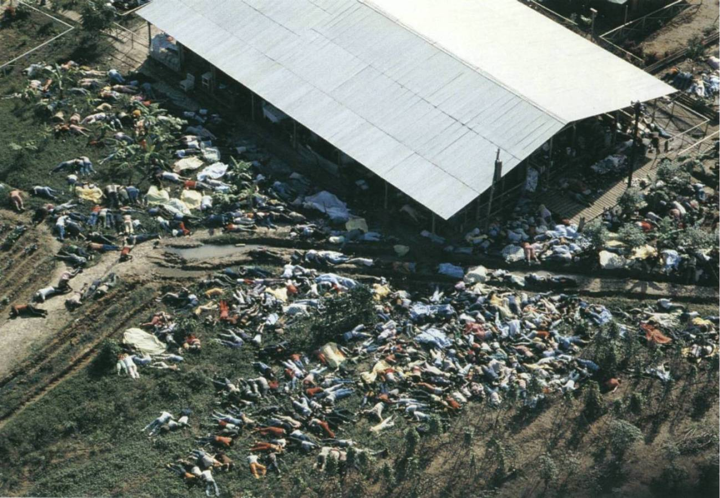

Slide 7
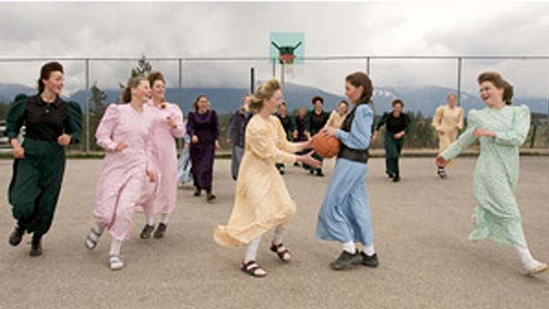
Bountiful
Near Cranbrook in British Columbia
Still operating and under police investigation for the past decade.
Allegations of polygamy and child abuse
In 2007, a connected cult was raided and all of the children were removed from their parents.

Slide 8
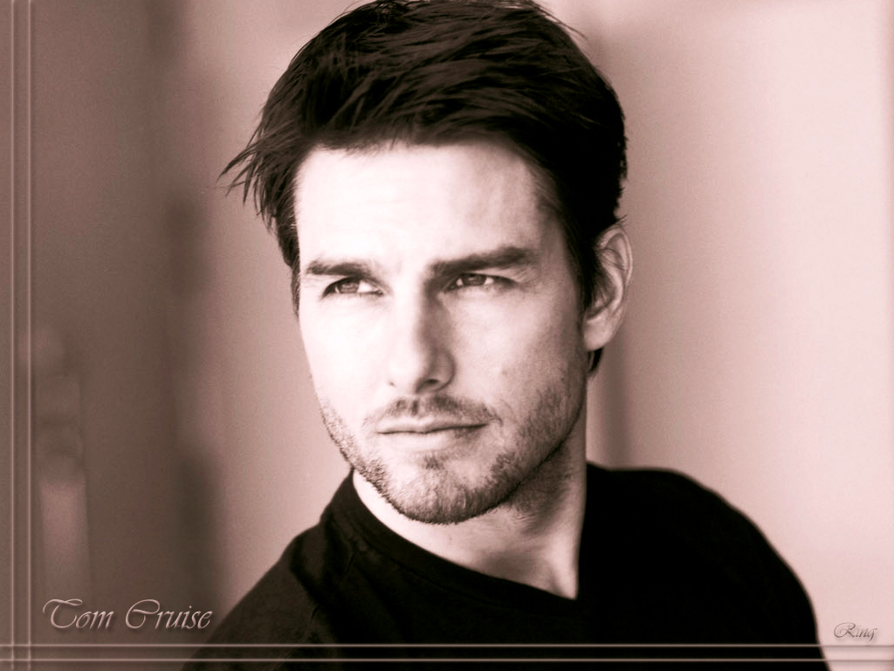
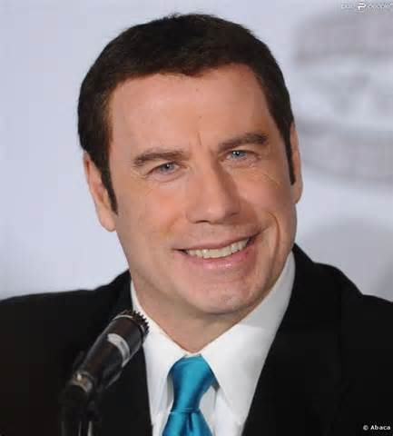
Scientology
Believe that we have alien souls that have merged with out own.
Generates huge profits and intimidates people who criticize the cult. Operates internationally.
Attempt to attract celebrity members to legitimize their operations.

Slide 9
How does it work?
Find people who are lost and confused, looking for direction in life.
Offer them direction and use brainwashing techniques to exert mind control.
Cut them off from their family and friends.
Deprive them of their finances and limit their movement.
Break down their individuality and encourage group conformity.
You must have charismatic cult leaders to be convincing.

Slide 10
Techniques
1. Removal of privacy.
2. Disinhibition – encouraging childlike behavior.
3. Love bombing – creating mood of acceptance and family.
4. Peer Pressure – using other cult members to pressure conformity.
5. Confusing Doctrin – Gets them to reject logic.
6. Uncompromising Rules – set bedtime, etc. Sleep Deprivation
7. Strict Dress Code – Everyone dresses the same.
8. Change of Diet – New foods.
9. Admitting of sins and forgiveness
10. No Questions
11. Financial Commitment – You must invest money
12. Rejection of old value – including family and friends.

