Slide 1
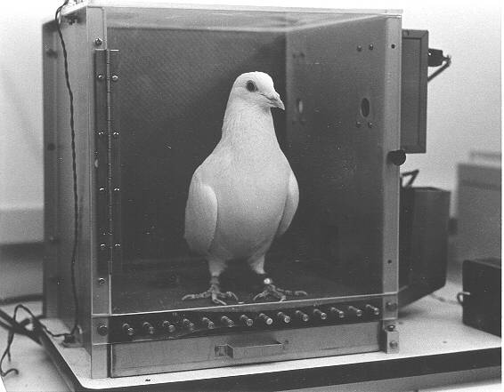
Behaviorism Review
Is this true? Are we really the product
Of a lifetime of training?

Slide 2
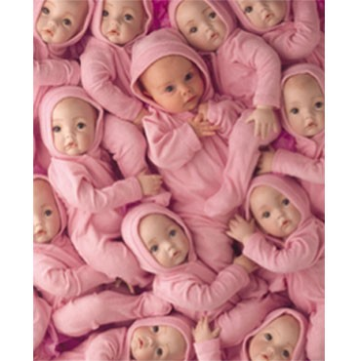
Behaviorism
"Give me a dozen healthy infants, well-formed, and my own specified world to bring them up in and I'll guarantee to take any one at random and train him to become any type of specialist I might select -- doctor, lawyer, artist, merchant-chief and, yes, even beggar-man and thief” – Albert Watson
Is this true? Are we really the product
Of a lifetime of training?

Slide 3
Rejecting Freud
The Behavioral Revolution occurred because psychologist began to reject Freudian Psychology.
Many psychologist began to feel that Freud's emphasis on childhood, internal conflicts and sex was untestable and therefore not science.
What do you think? Is Freudian Psychology science?

Slide 4
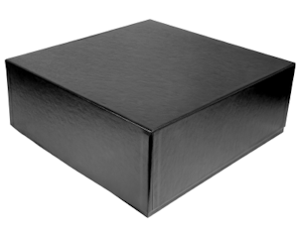
The Black Box
According to Behaviorists, the mind is a black box; we cannot ever really see what is going on in someone’s mind.
Therefore, the only thing that psychology should consider is human behavior, not emotions and feelings.
What advances in modern medicine have allowed us glimpses inside the black box?

Slide 5
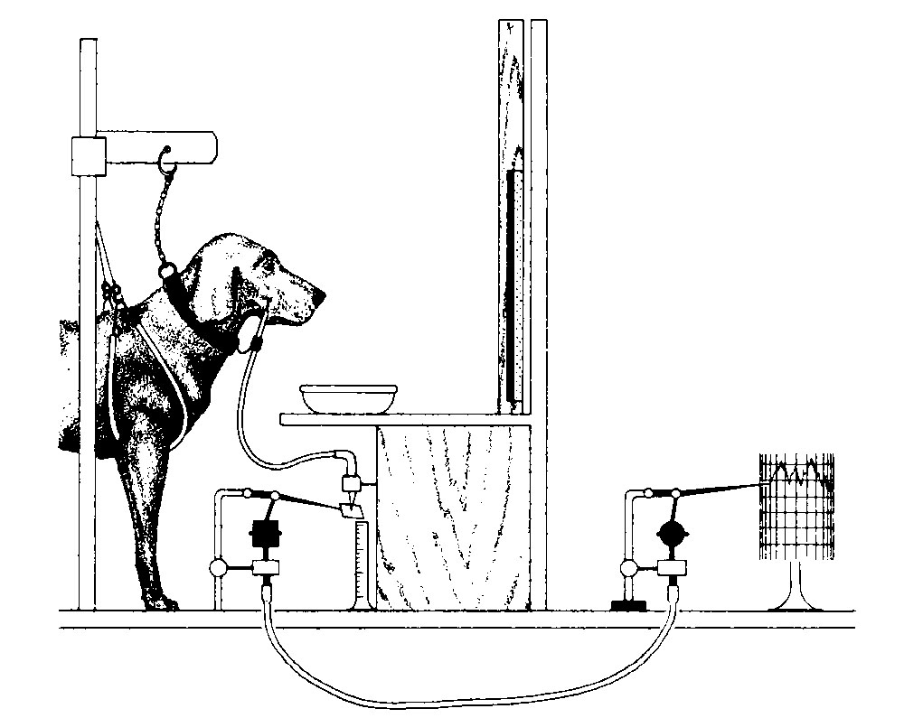
Ivan Pavlov
One of the first behaviorists, Ivan Pavlov created the concept of Classical Conditioning.
He trained dogs to associated the sound of a bell with receiving food.
He measured their salivation as a conditioned response to the bell.
This is generally called a Pavlovian Response

Slide 6
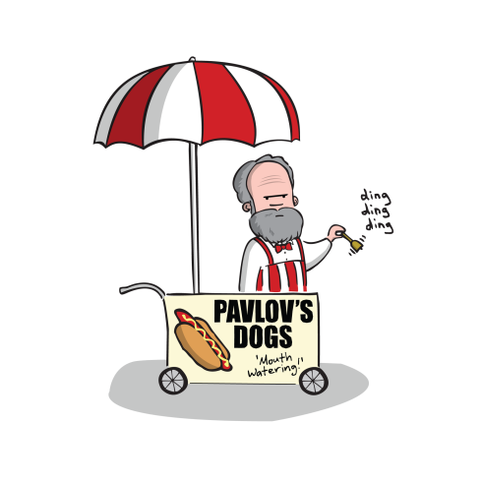
Classical Conditioning
Discovered by Russian physiologist Ivan Pavlov, classical conditioning is a learning process that occurs through associations between an environmental stimulus (bell) and a naturally occurring stimulus (salivation).

Slide 7
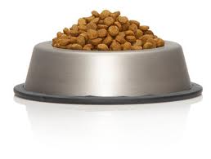
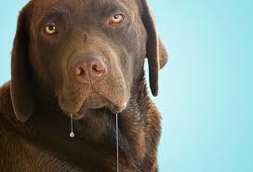
Take a naturally occurring relationship
The dog naturally salivates when it see the food.
Label the above:
Unconditioned Stimulus
Conditioned Stimulus
Neutral Stimulus
Unconditioned Response
Conditioned Response.

Slide 8
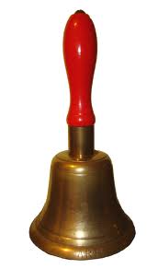
Add a neutral stimulus
Pair the food with the bell and Repeat, Repeat, Repeat. The dog learns to associate the bell with food.
Label the above:
Unconditioned Stimulus
Conditioned Stimulus
Neutral Stimulus
Unconditioned Response
Conditioned Response.

Slide 9
Remove the original stimulus
Now, we just ring the bell. And what is this? The dog is salivating without the food being there!
Label the above:
Unconditioned Stimulus
Conditioned Stimulus
Neutral Stimulus
Unconditioned Response
Conditioned Response.

Slide 10
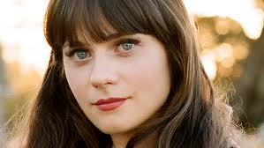
One More Time
Label the above:
Unconditioned Stimulus
Conditioned Stimulus
Neutral Stimulus
Unconditioned Response
Conditioned Response.

Slide 11
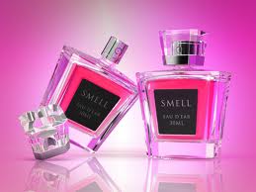
Label the above:
Unconditioned Stimulus
Conditioned Stimulus
Neutral Stimulus
Unconditioned Response
Conditioned Response.

Slide 12
Label the above:
Unconditioned Stimulus
Conditioned Stimulus
Neutral Stimulus
Unconditioned Response
Conditioned Response.

Slide 13
Common examples
Kids who often get strep throat, after much swabbing of their throat, begin to gag as soon as they see the doctor with the swab.
Hearing a teacher, roommate, boyfriend/girlfriend say to you, “We need to talk”. Upon hearing this phrase your stomach “flutters”.

Slide 14
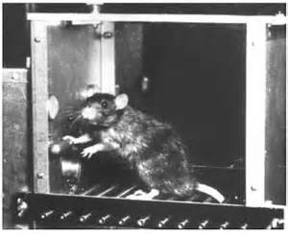
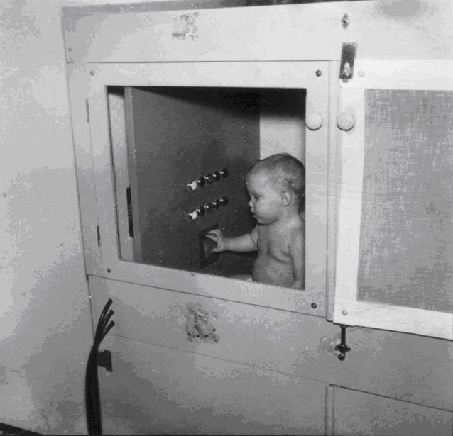
B.F. Skinner
Is credited for discovering Operant Conditioning
One of the leaders of Behaviorism.
Also know for inventing the “Skinner Box” where rats and pigeons pressed levers for food.
His daughter in a Skinner Box

Slide 15
Operant Conditioning
Operant conditioning is a method of learning that occurs through rewards and punishments for behavior
In Operant Conditioning we take a spontaneous voluntary behavior and try to modify it.
We can Reinforce it to increase the behavior
We can Punish it to decrease the behavior

Slide 16
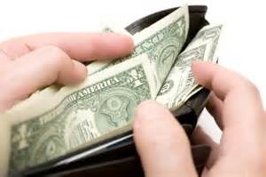
Positive Reinforcement
Lets say we wanted to modify the behaviors of our parents. In particular, we want them to give us money.
When they do give money we can use Positive Reinforcement = Add something good to increase the behavior.
How could we positively reinforce the behavior when they give us money?

Slide 17
Negative Reinforcement
When they do give money we could also use Negative Reinforcement = Remove something Bad
How could we negatively reinforce the behavior when they give us money?

Slide 18
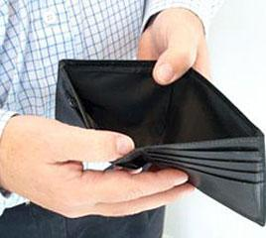
Positive Punishment
When they do not give money we could use Positive Punishment = We add something bad to decrease the behavior.
How could we positively punish the behavior when they give do not give us money?

Slide 19
Negative Punishment
When they do not give money we could also use Negative Punishment = We take away something good.
How could we negatively punish the behavior when they give do not give us money?

Slide 20
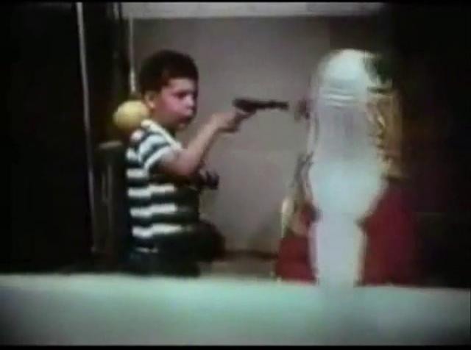
Social Learning
Albert Bandura believed that Classical and Operant Conditioning could not account for all learning.
He argued that most of our behaviors are learned by watching other people.
What does the Bobo Doll experiment tell us about how children learn?

Slide 21
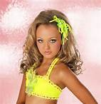
Modeling
This process of learning through observation is called modeling in psychology. It contains four steps:
Attention: In order to learn, you need to be paying attention
Retention: The ability to store the information
Reproduction: Actually performing the behavior you observed.
Motivation: You must be motivated to reproduce the behavior
How would the concept of modeling apply to how children dress and modern beauty pageants?

Slide 22
The Modern Era
While Psychology has moved on from hardcore behaviorism it is still an important aspect of modern psychology
The concepts of behaviorism are still valid and are used in modern research and types of therapies.
The behavioral revolution led psychology into the modern scientific era.

