Slide 1

Anxiety
Disorders

Slide 2

Major Symptoms of Anxiety
Nervous habits
Muscle tension
Feeling on edge
Restlessness
Difficulty concentrating
Irritability
Sleep disturbance

Slide 3
Anxiety
Every person experiences anxiety (big tests, school projects, work environment, relationship problems, etc.); anxiety disorders differ from these feelings in that anxiety begins to take control and dominate life.
There are three major types of anxiety disorders (that we will be looking at): ,
Phobic Disorders,
Obsessive-Compulsive Disorder (OCD)
Post-Traumatic Stress Disorder.

Slide 4
Causes of Anxiety Disorders
Heredity – some of us inherit a predisposition, or likelihood, for developing anxiety disorders. The specific fear is not inherited, but the predisposition to be fearful is.
Brain Function – brain-scanning techniques show that people with anxiety disorders have brains that literally function differently from those of people who do not
Evolution – we are likely to fear situations that posed danger to the earliest humans. Anxiety disorders may be a malfunctioning of this mechanism.
Conditioning – Anxieties may be learned either by observation or through experience.

Slide 5
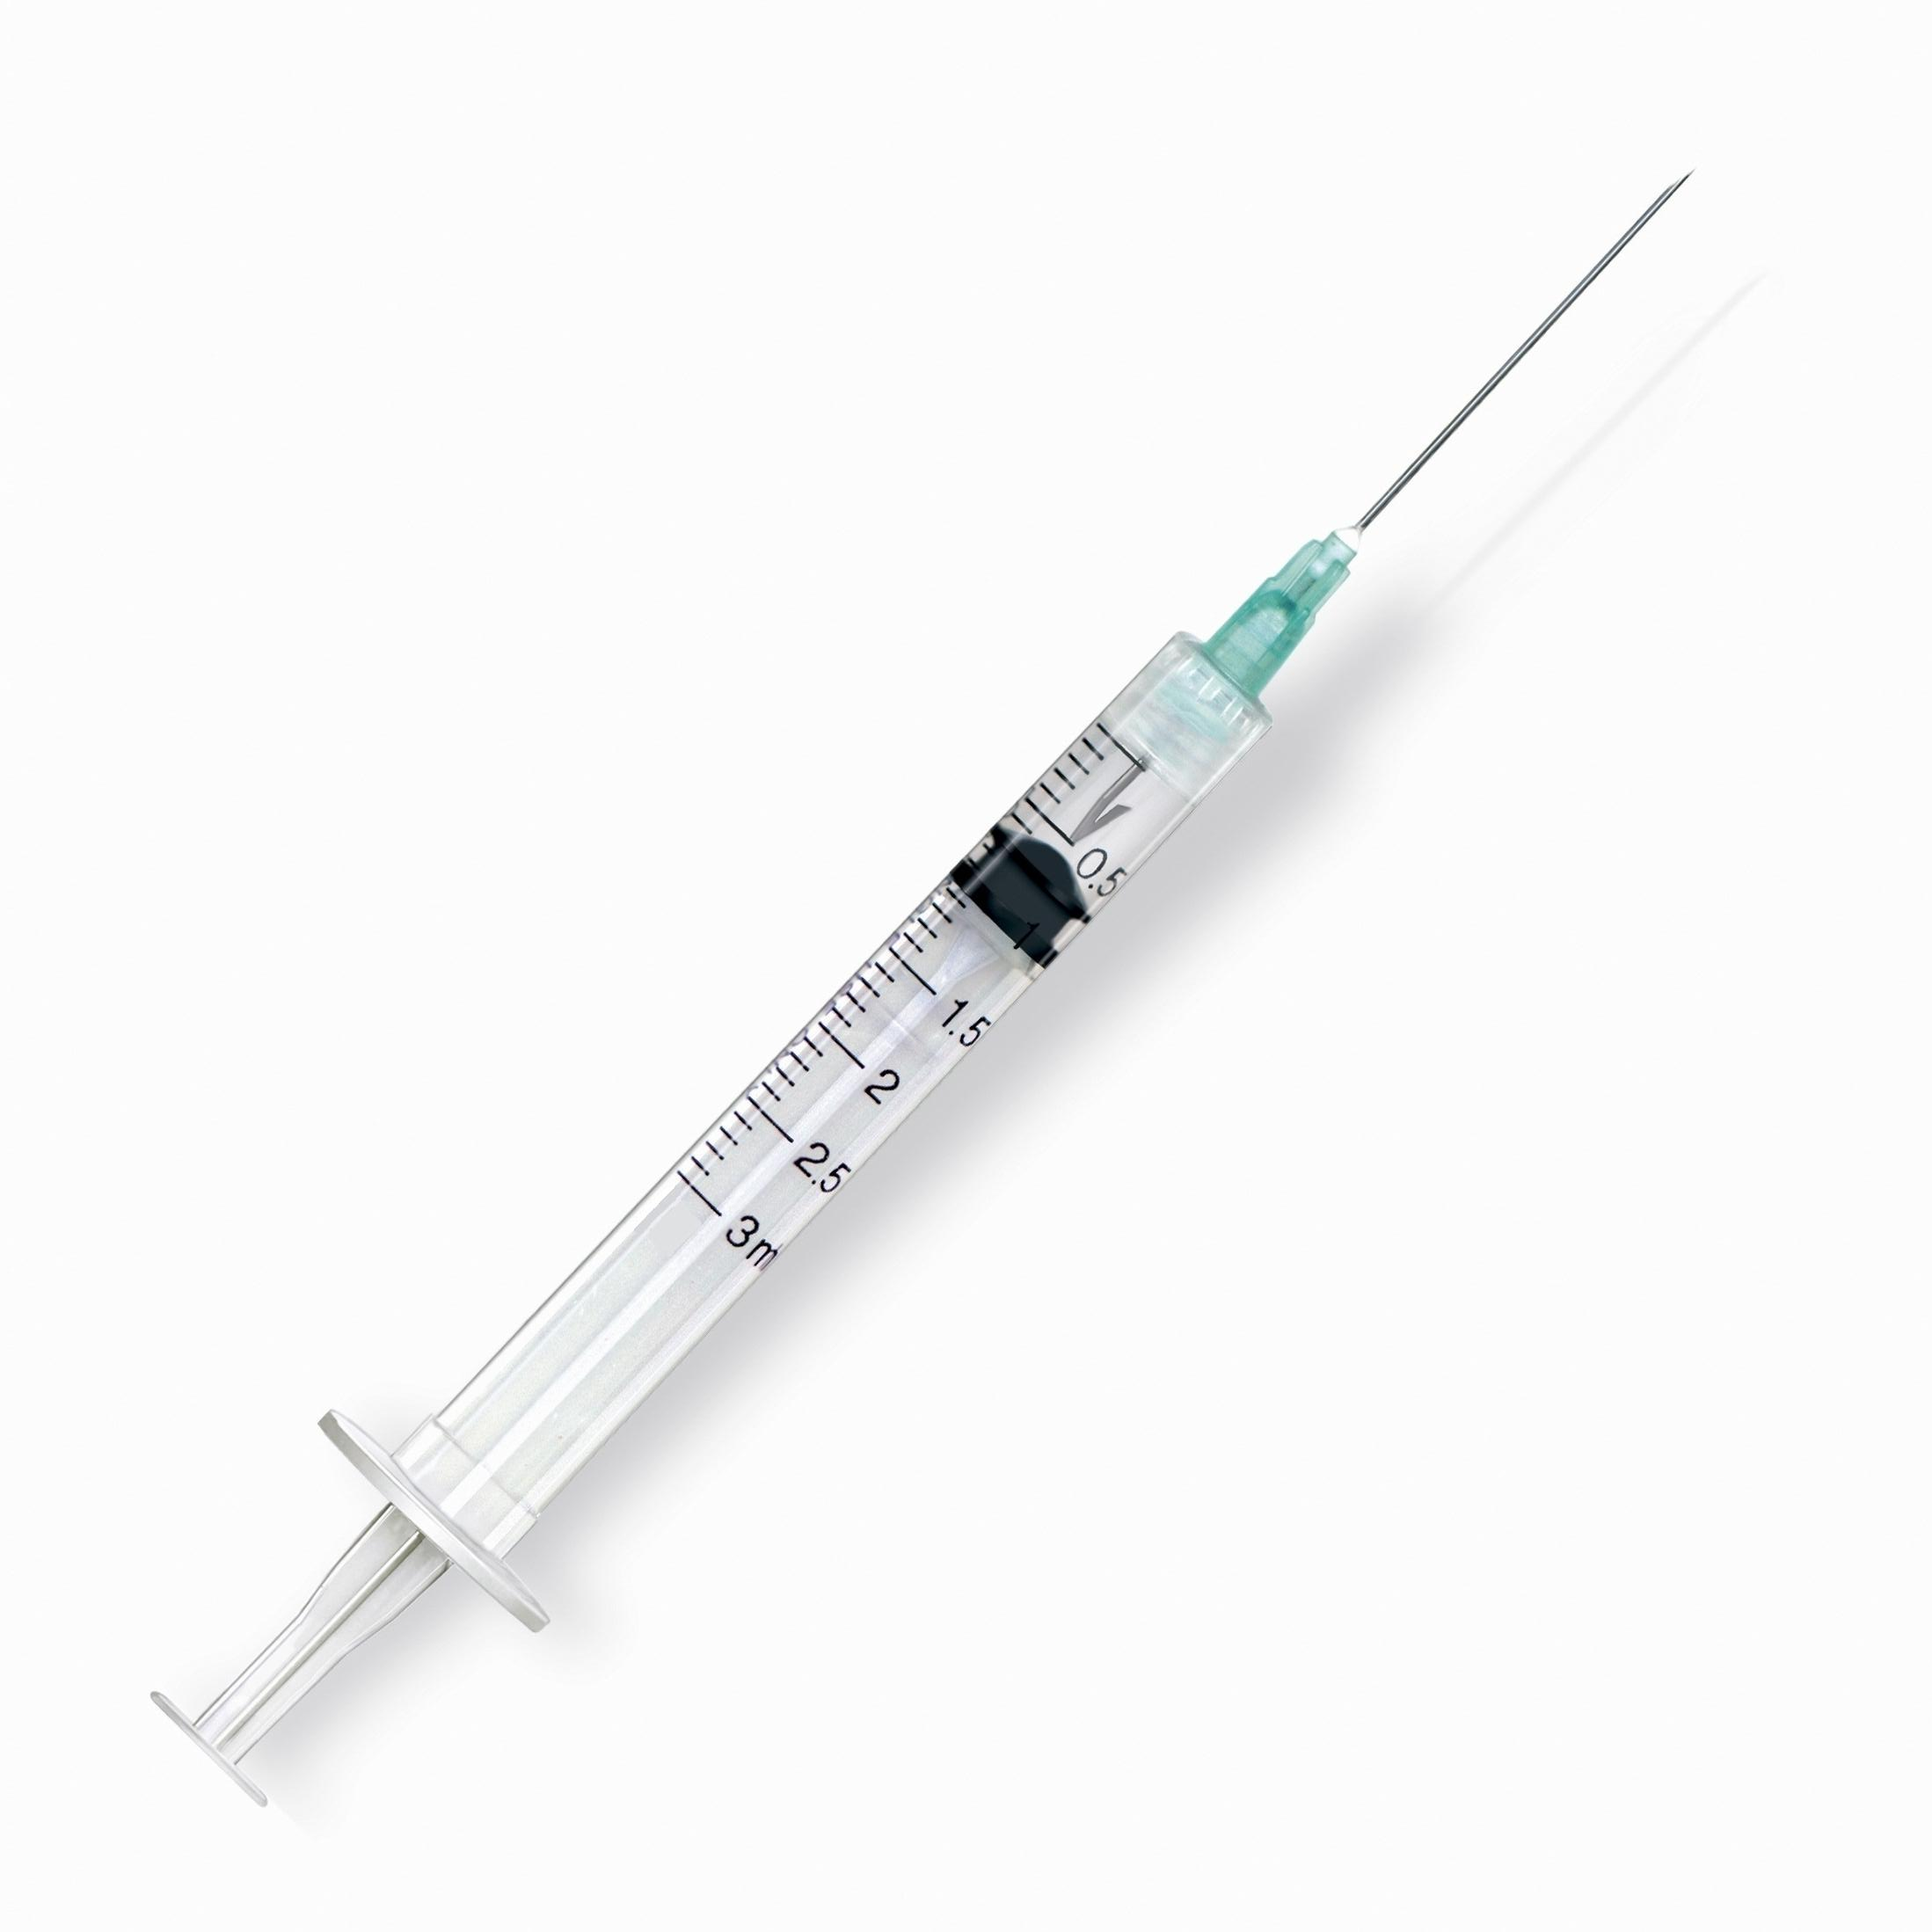
Phobic Disorders
More than just a fear!
Person becomes disabled and overwhelmed in the presence of certain objects or situations.
Must be disruptive and irrational to be considered a phobia.
How would having an unreasonable fear of
Needles be disruptive to a person’s life?

Slide 6
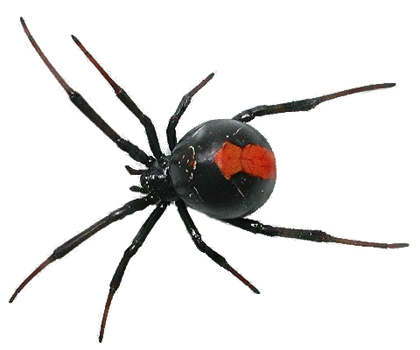
Three Categories of Phobias
Social Phobia
  Fear in social situations
  Extreme difficulty speaking in public
Simple Phobia
  Fear of a particular object or situation
Agoraphobia
  Fear of situations the person views as difficult to escape if panic begins to build up
  May end up being “trapped” in their own home
Do you have an irrational fear of something?

Slide 7
Name | Phobia of
hematophobia | Blood
nyctophobia | Darkness
claustrophobia | Enclosed Space
spermophobia | Germs
acrophobia | Heights
musophobia | Mice
ophidiophobia | Snakes
arachnophobia | Spiders
spheksophobia | Wasps
aerophobia | Air
ommatophobia | Eyes
sciophobia | Shadows
phagophobia | Swallowing

Slide 8

OBSESSIVE COMPULSIVE DISORDER
Obsession = thoughts that intrude into a person’s mind repeatedly (usually negative)
Compulsion = repetitive actions (checking and rechecking, required steps to follow, hand washing, counting)
Someone with obsessive thoughts may feel compelled to complete a ritualized behavior in order to reduce feelings of anxiety.
Do you have a compulsion? How do you feel if you
don’t enact it?

Slide 9

Compulsions and Obsessions
Most common obsessions are:
Concern with dirt, germs, or toxins
Something terrible happening (fire, death, illness)
Symmetry, order, or exactness
Excessive hand washing
Most common compulsions are:
Excessive hand washing, bathing, tooth brushing, or grooming
Repeating rituals (in/out of a door, up/down from a chair)
Checking doors, locks, appliances, car brake, homework

Slide 10
POST TRAUMATIC STRESS DISORDER
PTSD first identified during Vietnam conflict.
Symptoms include:
  Nightmares
  Persistent fear
  Troubling memories
  Flashbacks
Aside from war, what other traumatic
Experience might lead someone toward
Having PTSD?

Slide 11
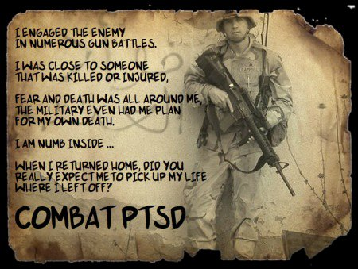
PTSD
The negative consequences of bad experiences can produce increased anxiety and other symptoms for many years.
PTSD is caused by an overload of stress in the brain.
How can we help people returning from
War to deal with their issues?

