Slide 1
A Quick Introduction to the 7 Major Perspectives in Psychology

Slide 2
The 7 Perspectives
These are the major division in psychology
Although they are presented as separate, they are really like different ways of looking at the same issue

Slide 3
Psychodynamic
Concentrates on the subconscious and how we deal with our subconscious urges (sex & violence)
Focuses on the past and childhood problems.
Childhood issues and traumas need to be resolved.
Humans are controlled by their unconscious mind. The best way to understand psychology is to look at the unconscious mind.

Slide 4
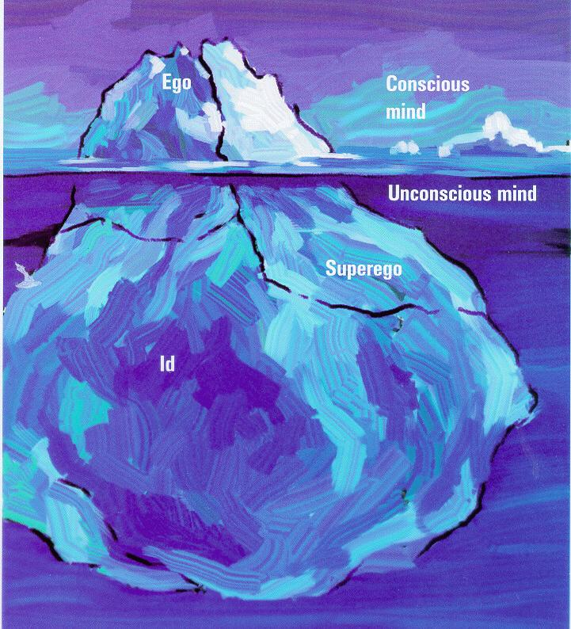
Psychodynamic
How might someone develop a fear of closed spaces? (Claustrophobia)
How might someone develop a paraphilia for tattoos?

Slide 5
Behavioral
Concentrates on behaviors and learning.
People continue behaviors because of rewards or stop because of punishments.
The subconscious is ignored.
We can never really see into someone’s mind. Therefore, psychology should only study observable behaviors.

Slide 6
Behavioral
How do we train dogs?
Could we train a human in the same ways?
https://www.youtube.com/watch?v=dgCvNSQ82Iw

Slide 7
Humanistic
Everyone is good and capable.
Focuses on feelings and achieving potential.
People need to have positive self-image.
Everyone is looking for love and fulfillment. The purpose of psychology should be to help people reach their potential.

Slide 8
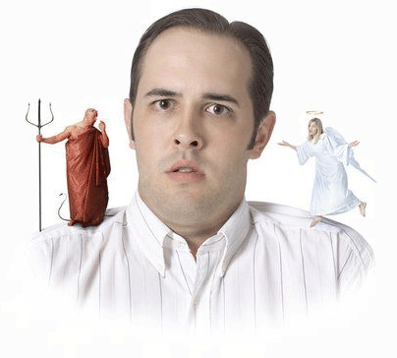
Humanisitic
Deep down is everybody really good?
What about people who have done really horrible things?

Slide 9
Cognitive
"You are what you think"
The human mind is like a computer
Much of people’s problems come from faulty thinking and incorrect perceptions about reality. These “thinking” problems need to be fixed.
Humans are really just very complex computers. The best way to understand psychology is to understand how we “process” information.

Slide 10
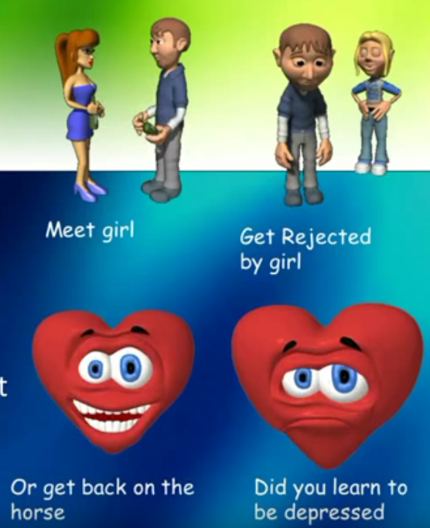

Slide 11
Biochemical
Concentrates on the link between medical anatomy and psychology.
The brain, genetics, chemistry, hormones, nervous system, etc.
Emphasis on treatment through medication.
The best way to understand psychology is to look at how the human brain functions.
Ex. Depression, bipolar disorder etc being caused by a chemical imbalance in the brain

Slide 12
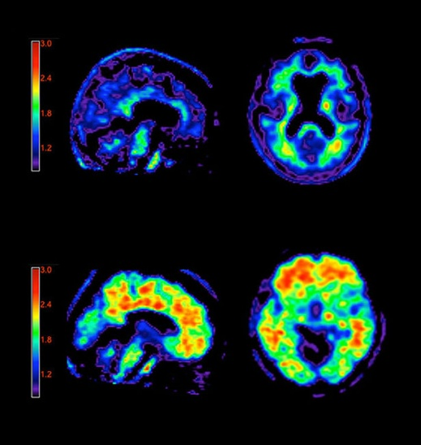
Biochemical
What advances have allowed us to see inside the brain? How has this helped us treat psychological disorders?

Slide 13
Sociocultural
Concentrates on the environment that surrounds a person
Culture, Family, Society, etc. How does this shape someone’s psychology?
Humans are the product of their environment. The best way to understand psychology is to look at the environment and culture that surround a person.

Slide 14
Sociocultural
How might a Psychologist using this perspective explain 50’s behavior before his success? What is he like now?

Slide 15
Evolutionary
Traits and behaviors that are useful are passed down through the generations.
The more successful behaviors allow people to be successful and reproduce.
Human behavior is based on millions of years of evolution. The best way to study psychology is by looking at how behaviors evolved.

Slide 16
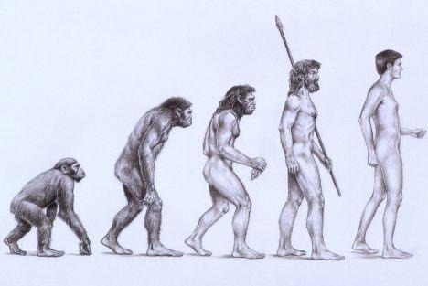
Evolutionary
Do you think that women are more selective than men when choosing a mate?

